Slide 1
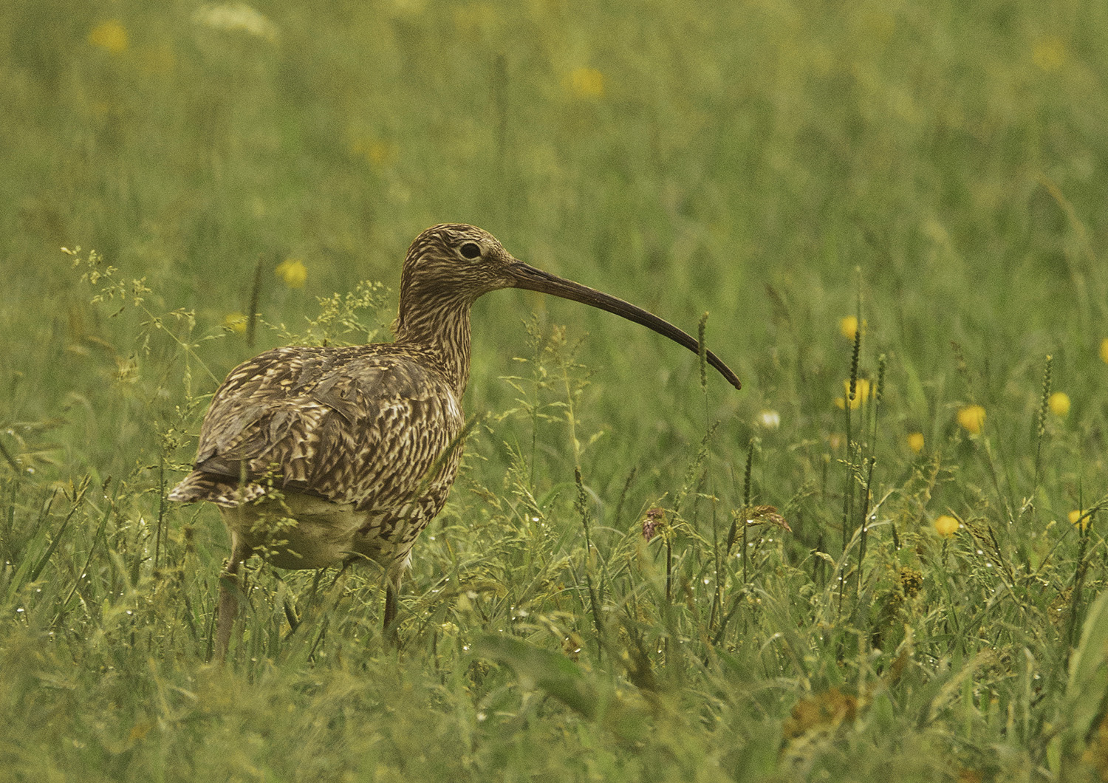
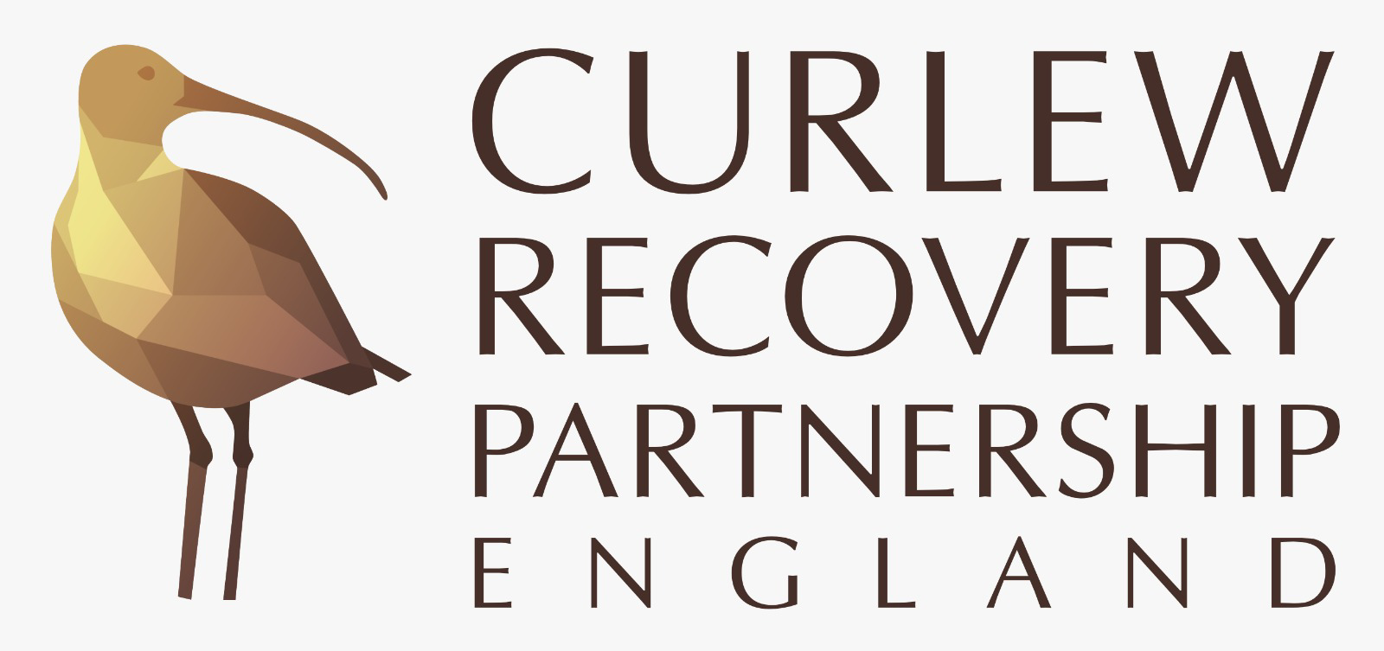
Introducing Curlews and the Curlew Recovery Partnership
Photo: Tom Streeter

Slide 2
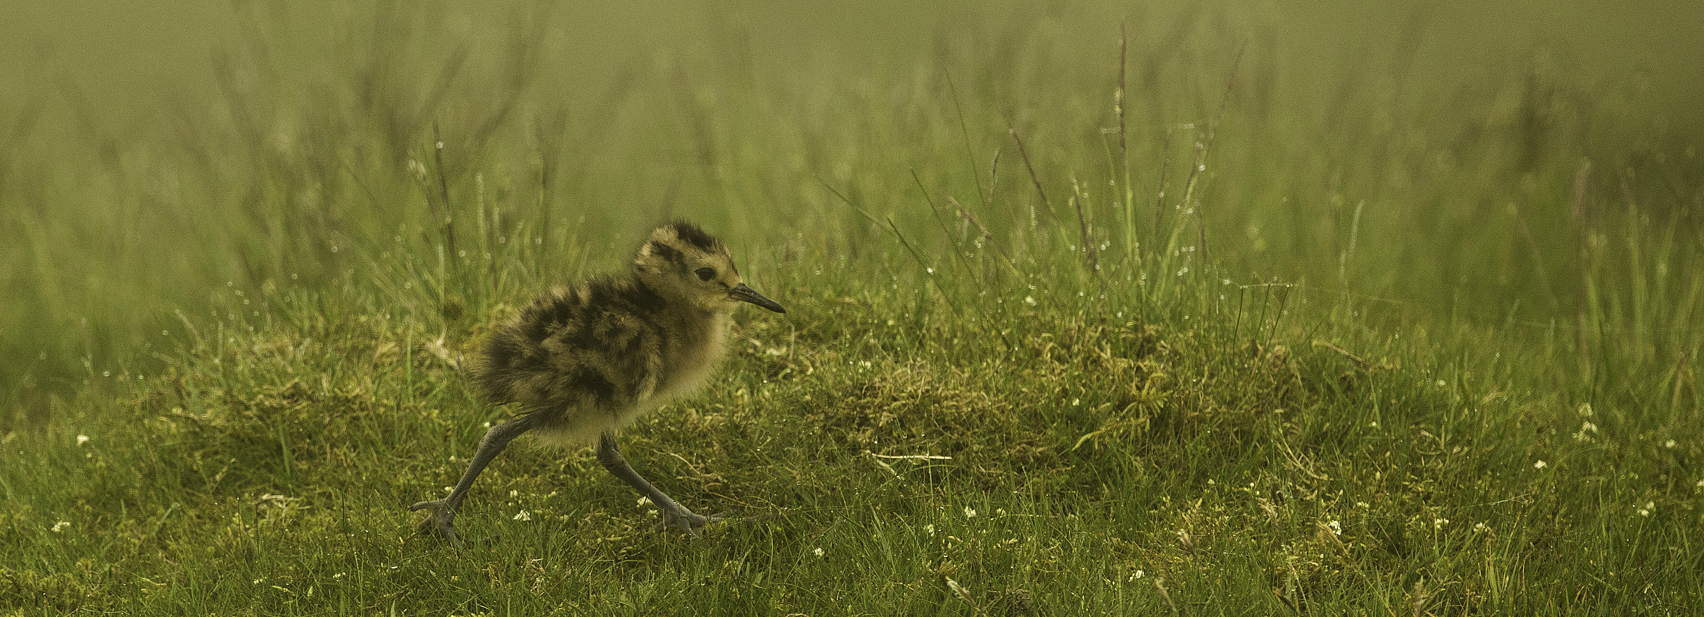
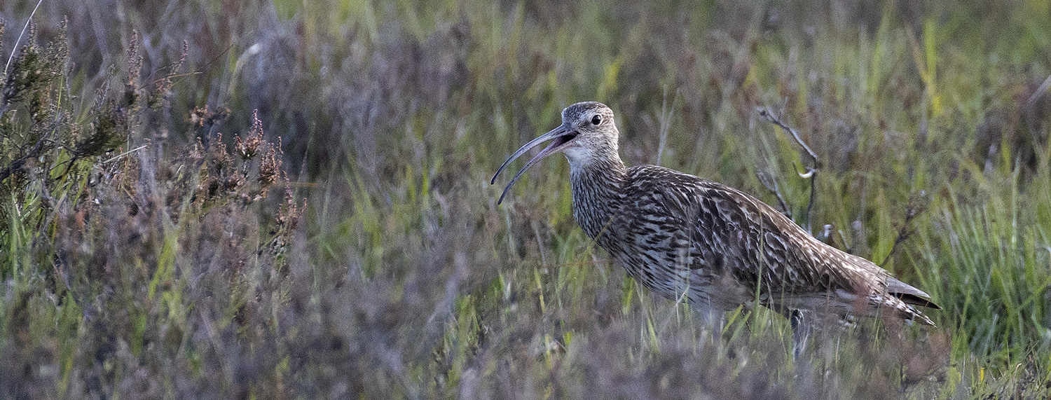
The Eurasian Curlew: Ecology
Eurasian Curlew (hereafter Curlew) is the largest wader in the UK, with a wingspan up to 1m
Females are slightly larger and longer-billed than males, and weigh about 1kg
They are long-lived birds, with a typical lifespan of 11 years but sometimes reaching up to 25 years
Their breeding season runs from Apr-July, although birds arrive on territory through Feb-Mar
They nest on the ground, and are easily disturbed during the breeding season
They usually lay four eggs, with incubation taking about four weeks and fledging a further five weeks
Chicks are independent soon after hatching, picking at small invertebrates
Adults mostly feed on invertebrates by probing or picking, but also eat prey as large as lizards!
Photo: Andy Page
Photo: Tom Streeter

Slide 3
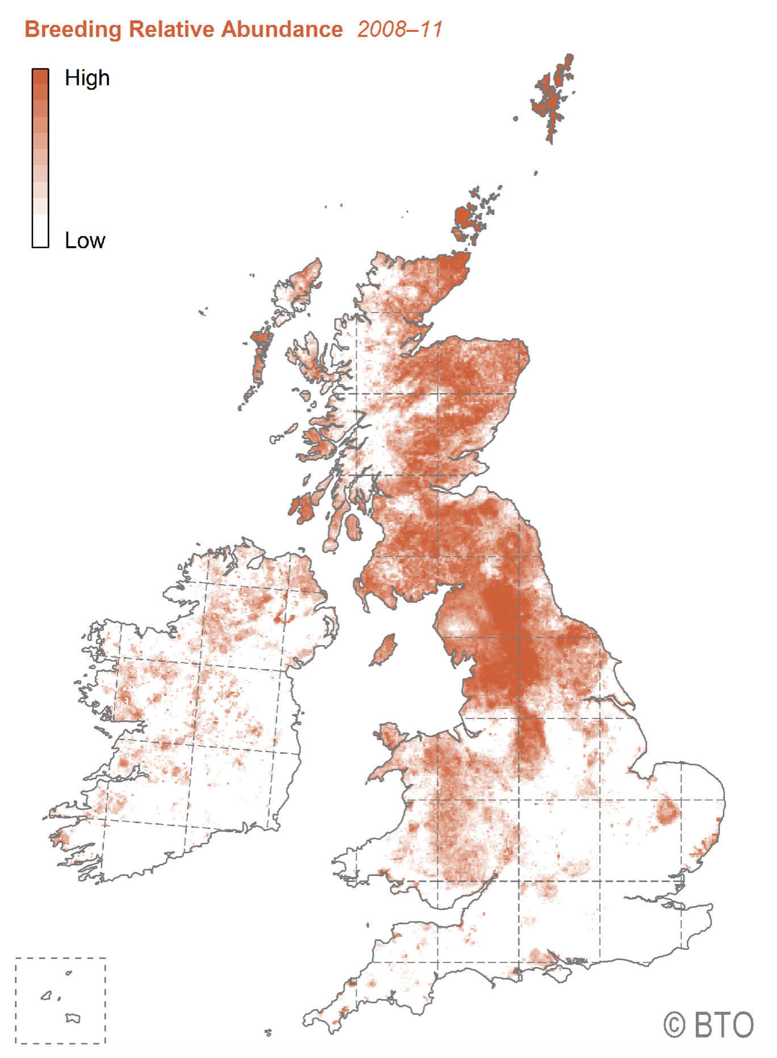
The Eurasian Curlew: Distribution and status (1)
Eurasian Curlew occurs across Europe and Asia in open landscapes
Near Threatened on IUCN Red List due to global decline
UK holds an estimated 58,500 breeding pairs, which is 20-25% of global population
However, numbers in the UK have halved over the last 25 years, so now UK red-listed
In England there are estimated to be 30,000 pairs, concentrated in the uplands
Real risk of extinction as a breeding species in Ireland, Wales and lowland southern England
Preferred habitats include upland moors, bogs and grasslands
Wintering population estimated at 125,000 birds
Preferred winter habitats are extensive coastal estuaries and grasslands
Highest abundance in the Pennines
Possibly as few as 2000 pairs remain south of the black line

Slide 4
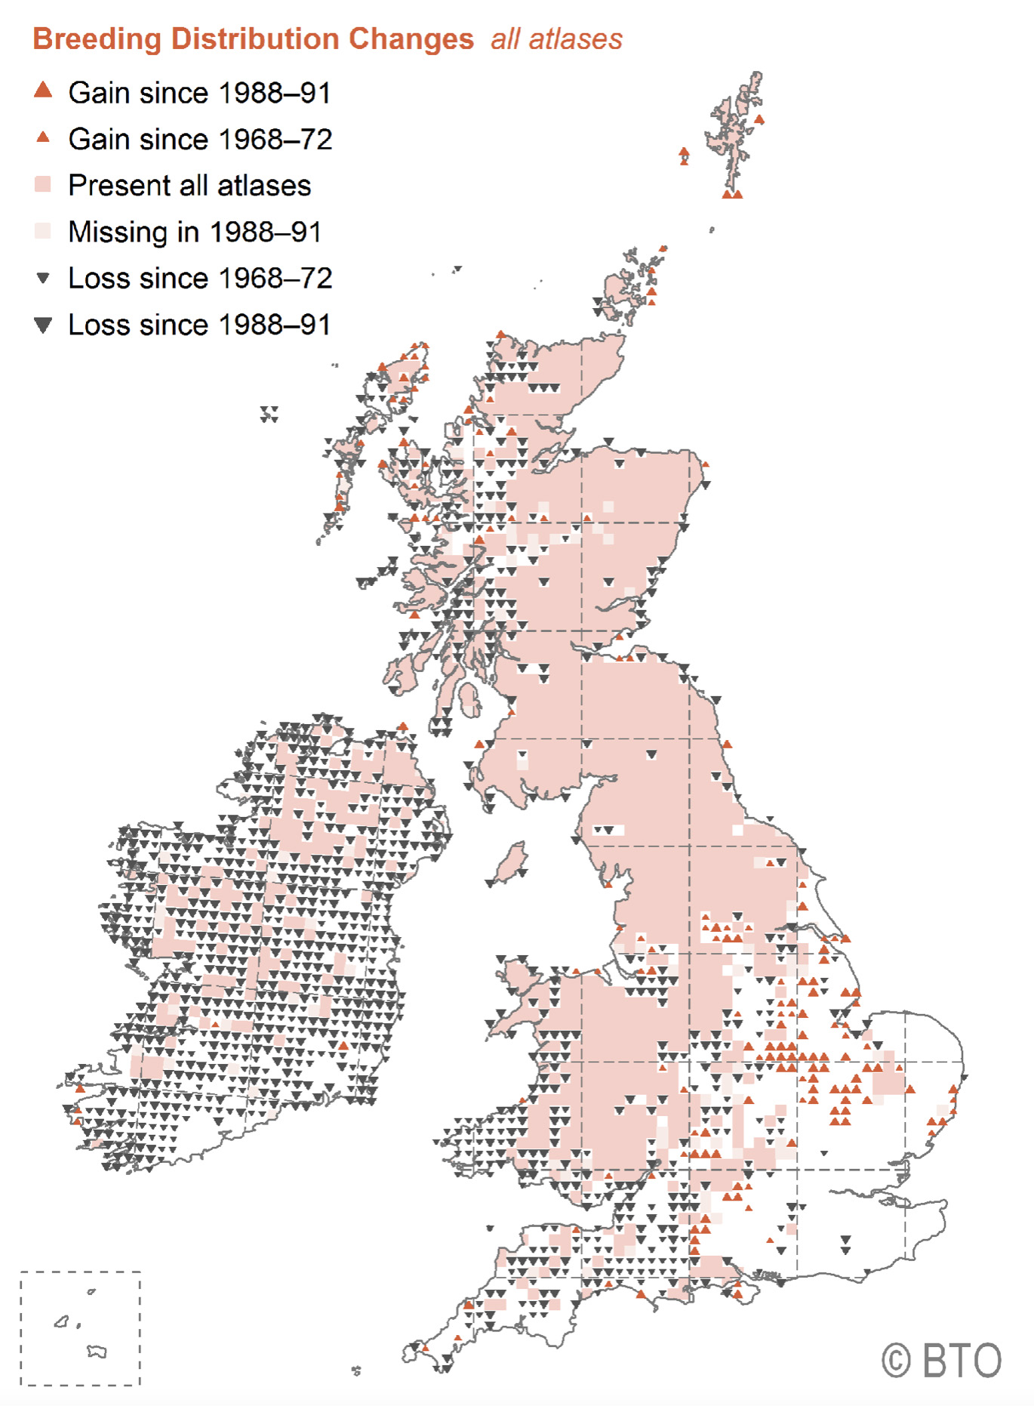
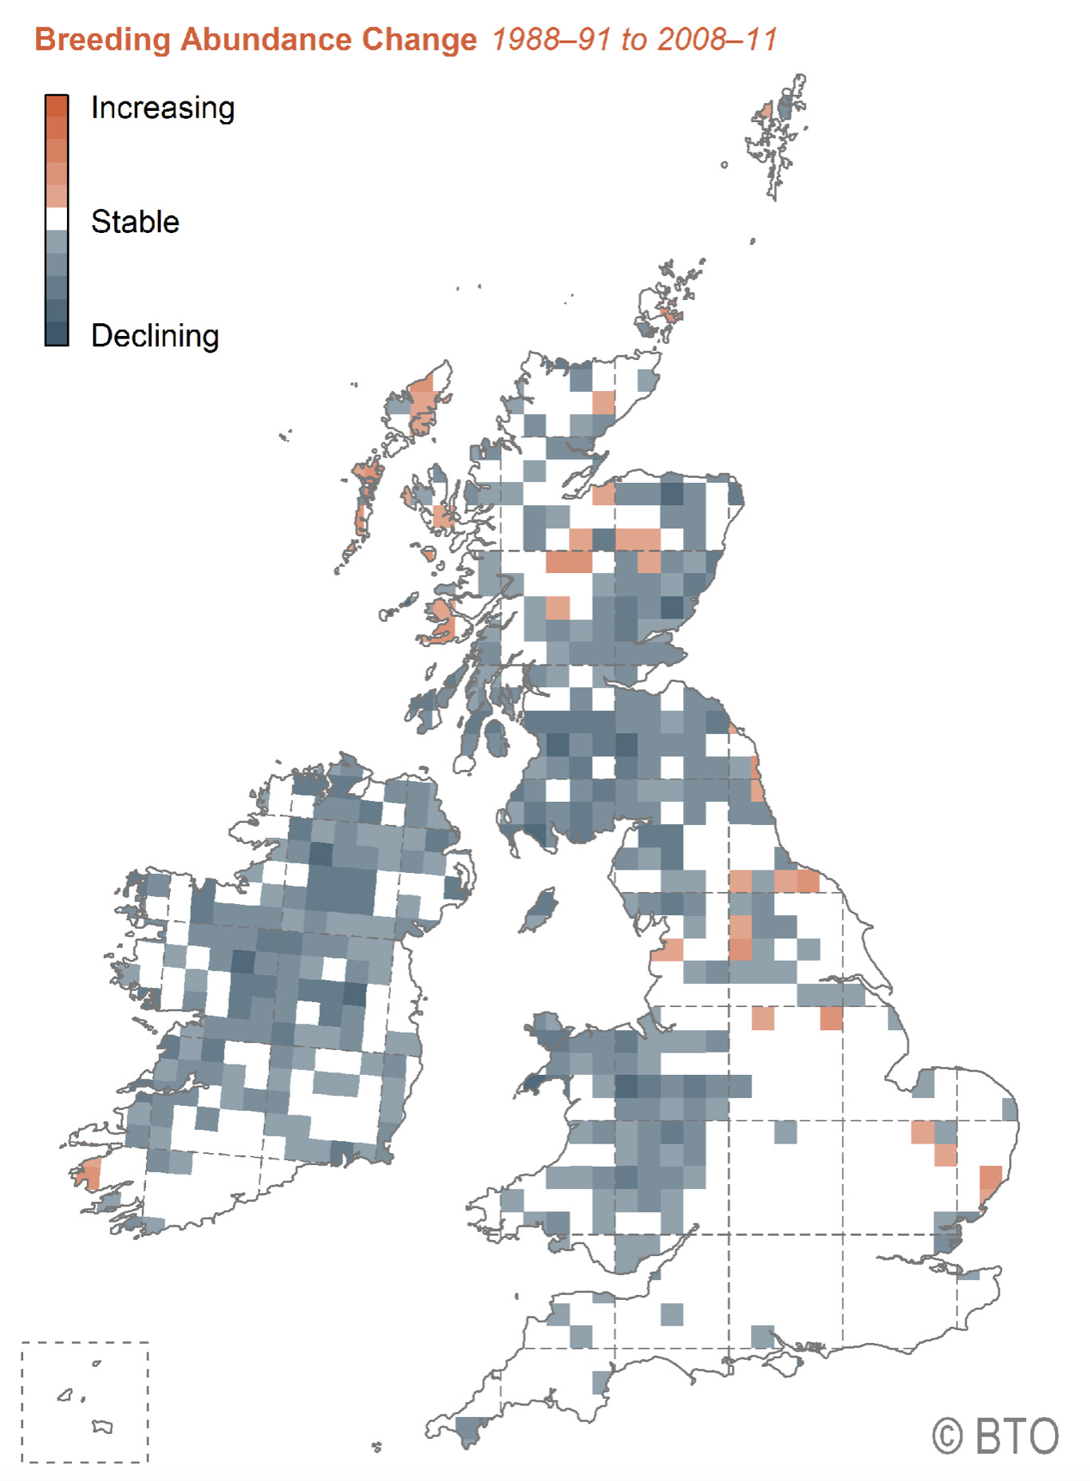
The Eurasian Curlew: Distribution and status (2)
This map shows that Curlews have been lost from much of Ireland and western and lowland UK
This map shows that Curlews are declining in abundance across most of their remaining range

Slide 5
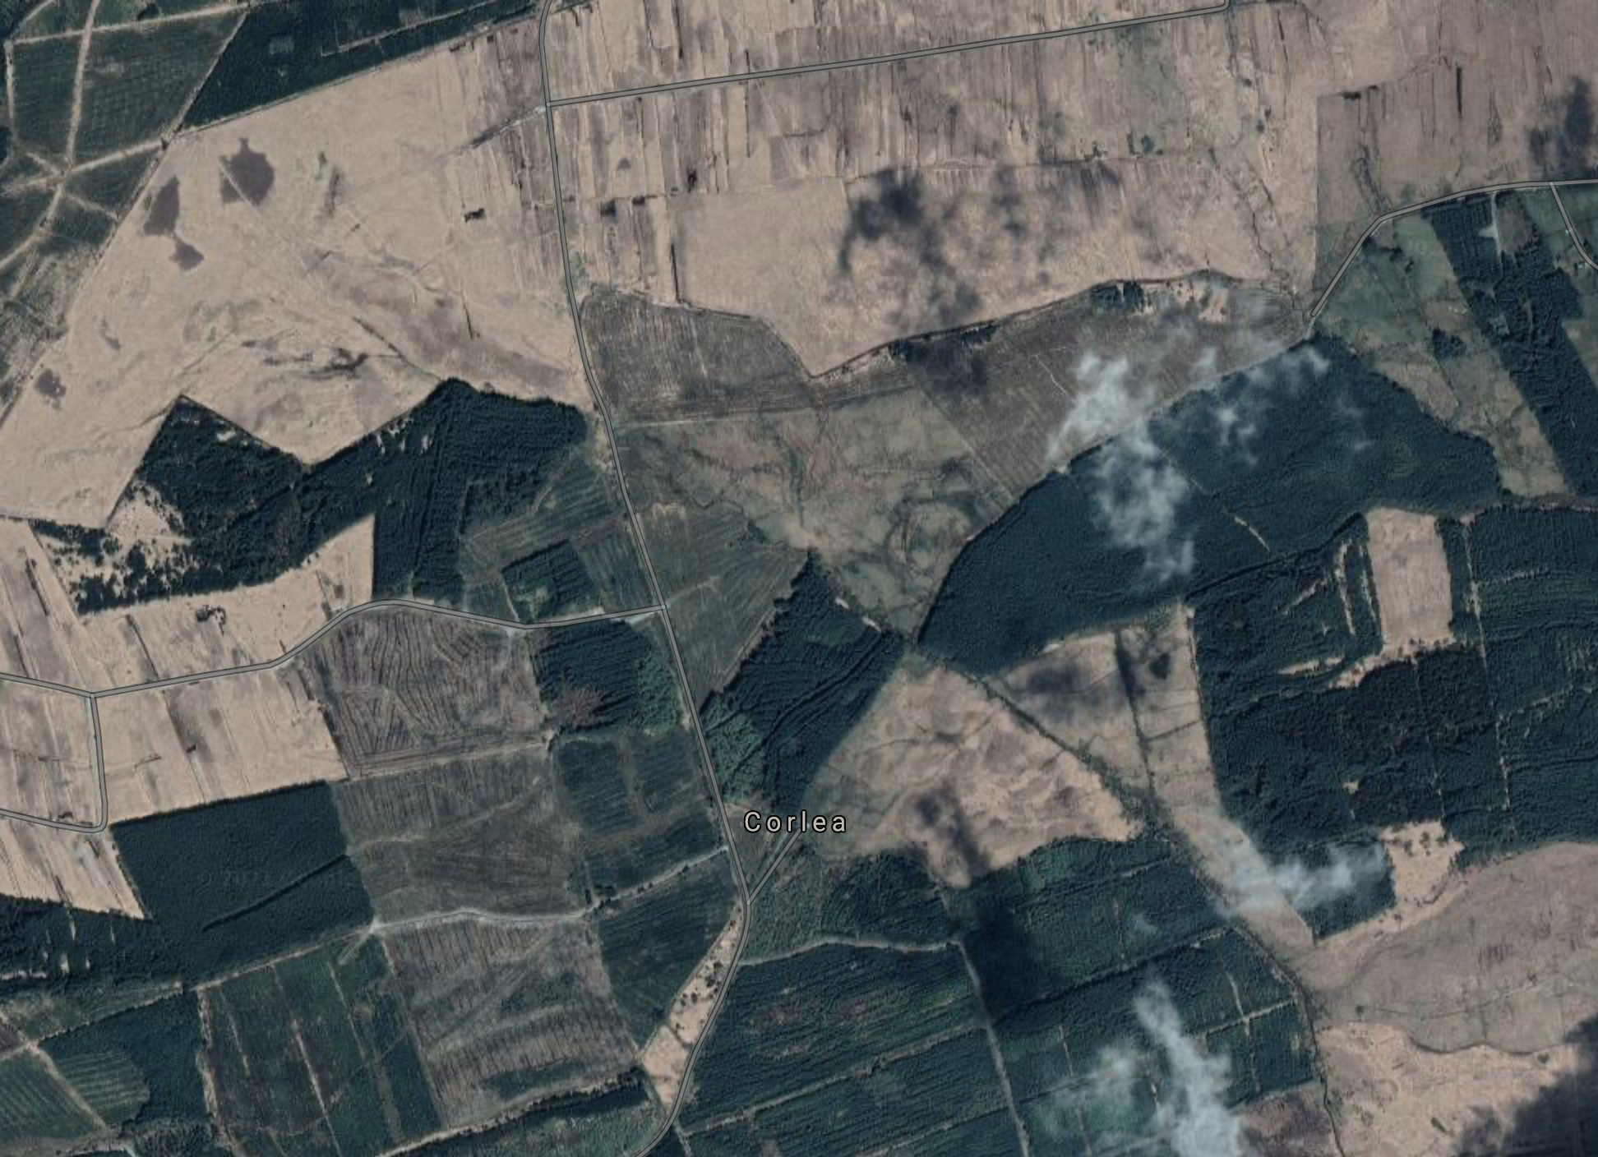
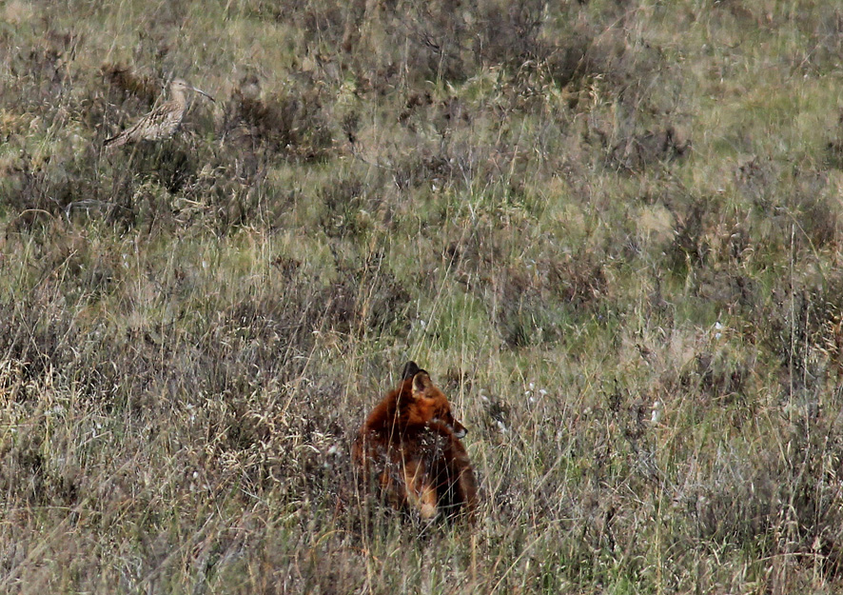
The Eurasian Curlew: Threats
Adult annual survival is generally very high (90%)
Recent declines are therefore primarily due to habitat loss and poor nesting success:
Habitat loss and degradation includes urban development, grassland intensification, drainage, afforestation and peat extraction
Some agricultural practices such as early rolling and cutting of grass for silage lead to direct loss of eggs and chicks
Abundant generalist predators such as Foxes and Carrion Crows are key threats at the egg and chick stage
Recreational disturbance may exclude birds from suitable habitat and can alert predators when birds are flushed off the nest
Climate change and extreme weather e.g. drying of breeding sites, inundation of coastal sites

Slide 6
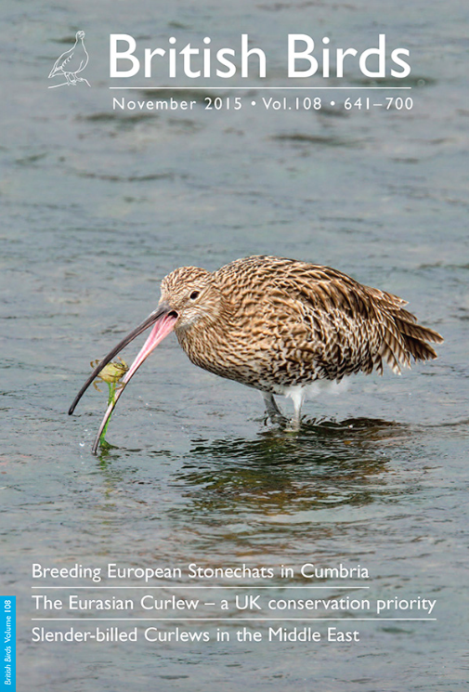
The Eurasian Curlew: Conservation action
Massive increase in awareness since 2015 paper in British Birds highlighted recent declines
Conservation action now being delivered in most important Curlew areas, including:
Habitat management at landscape-scale, e.g. by Farmer Clusters and on nature reserves
Predator exclusion and control, e.g. nest fencing, targeted culling
New techniques for survey and monitoring, e.g. satellite tracking, nest cameras, temp loggers
Head-starting, involving captive rearing of chicks before release back into the wild
Suitable mitigation solutions identified where designated sites for Curlews are impacted by development
Public awareness through media engagement and events such as World Curlew Day

Slide 7
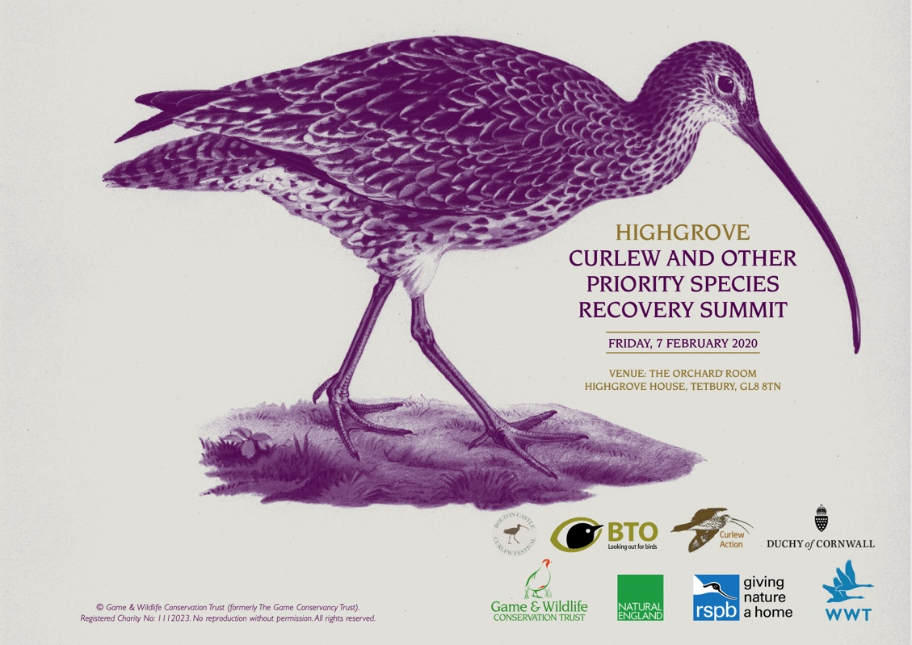
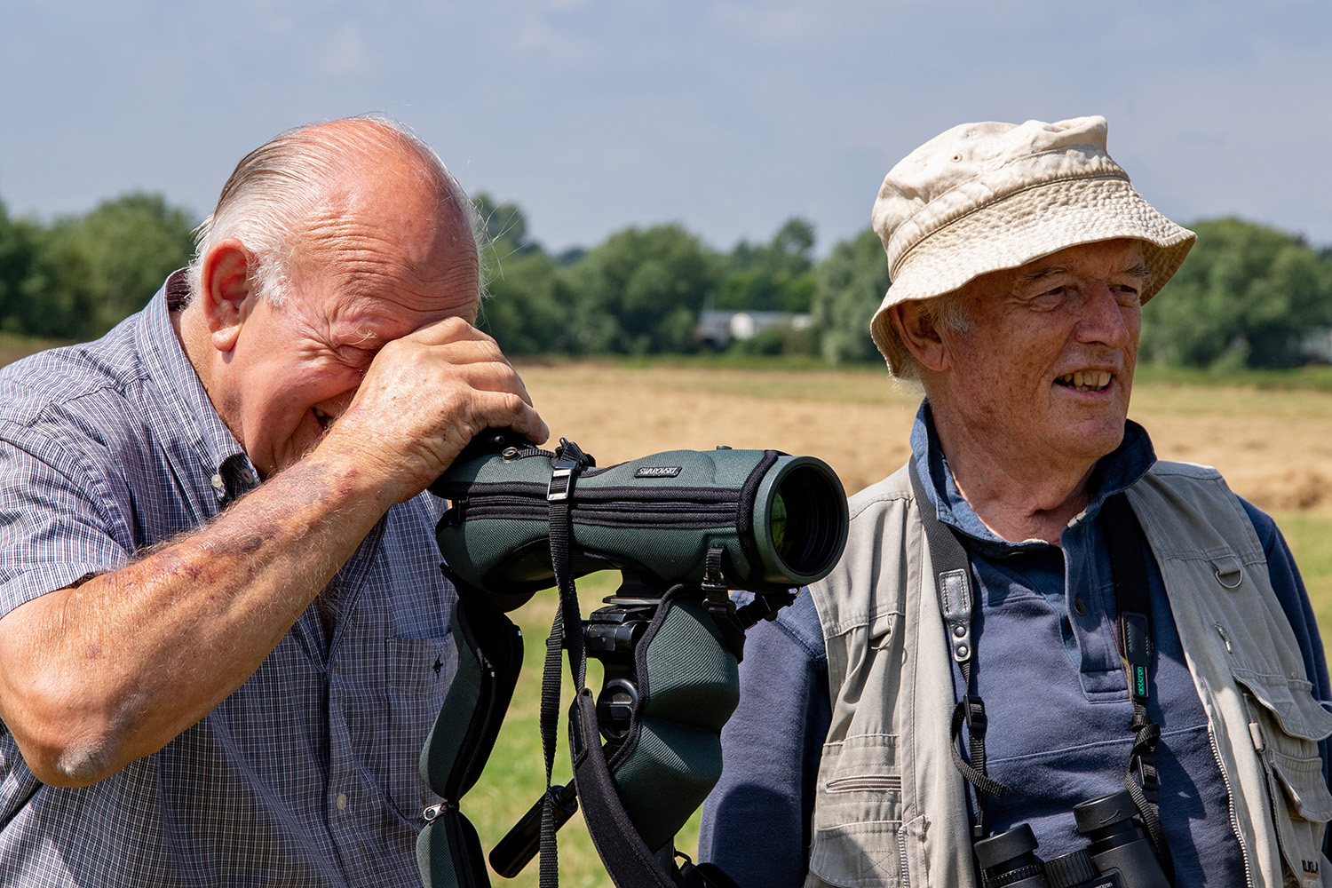
The Curlew Recovery Partnership: Origin and aims
Curlew summits in 2018-20 hosted by HRH The Prince of Wales at Dartmoor and Highgrove House, and by UK Government at 10 Downing Street
Key outcome was a shared desire for a co-ordinating body for Curlew conservation in England:
The Curlew Recovery Partnership (CRP) was officially launched on 01 March 2021
Initial funding from Defra of £60k and additional funding from WWT allowed a full-time manager to be employed
CRP provides co-ordination and support to those engaged in Curlew conservation, while also providing benefits for other threatened species and habitats and helping people to connect with nature.
CRP acts as a central hub and provides free-to-access resources and advice for anyone involved in Curlew conservation, e.g. farmers, gamekeepers, ornithologists, researchers and policy-makers
Photo: WWT

Slide 8
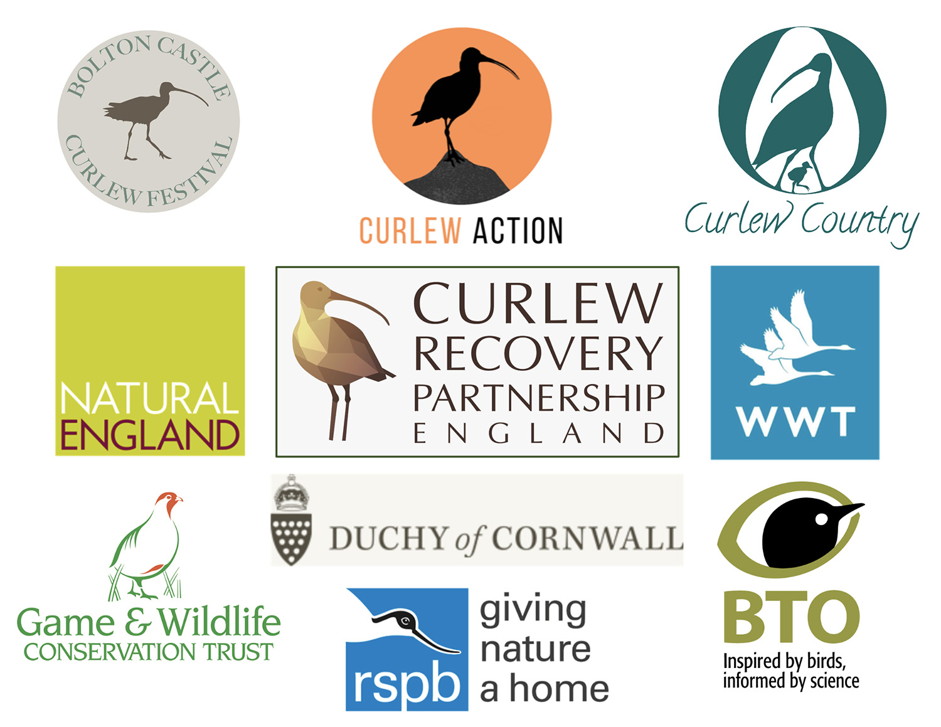
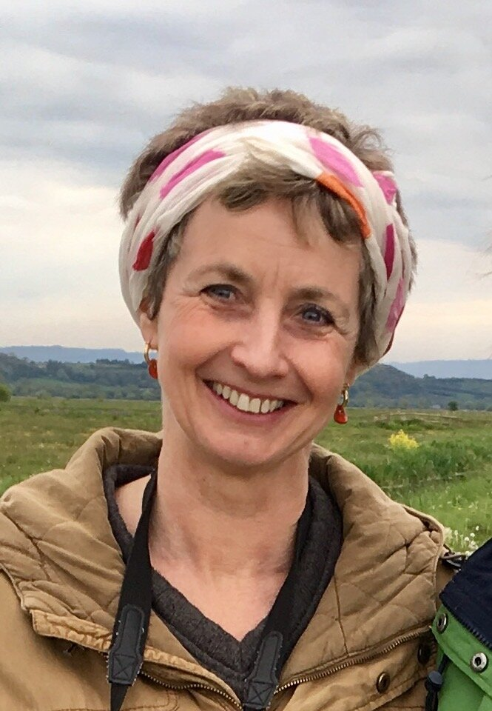
The Curlew Recovery Partnership: Steering Group
CRP Steering Group comprises nine organisations
that represent a wide range of interests in Curlew conservation
Chair
Mary Colwell
Manager
Prof Russell Wynn

Slide 9
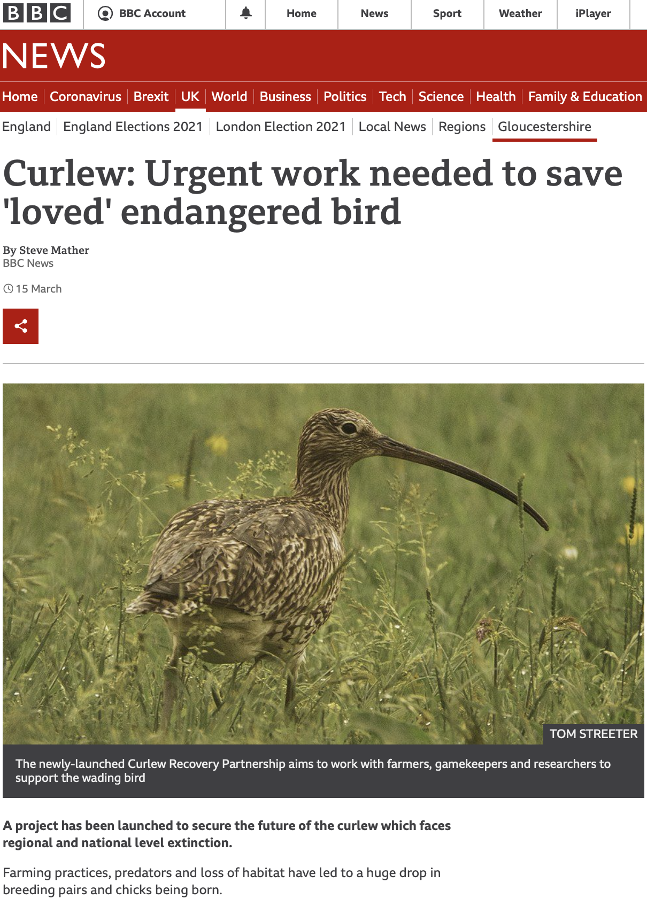
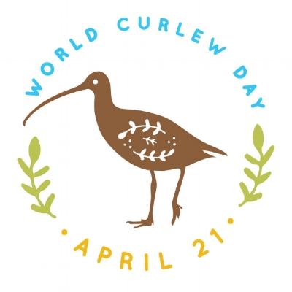
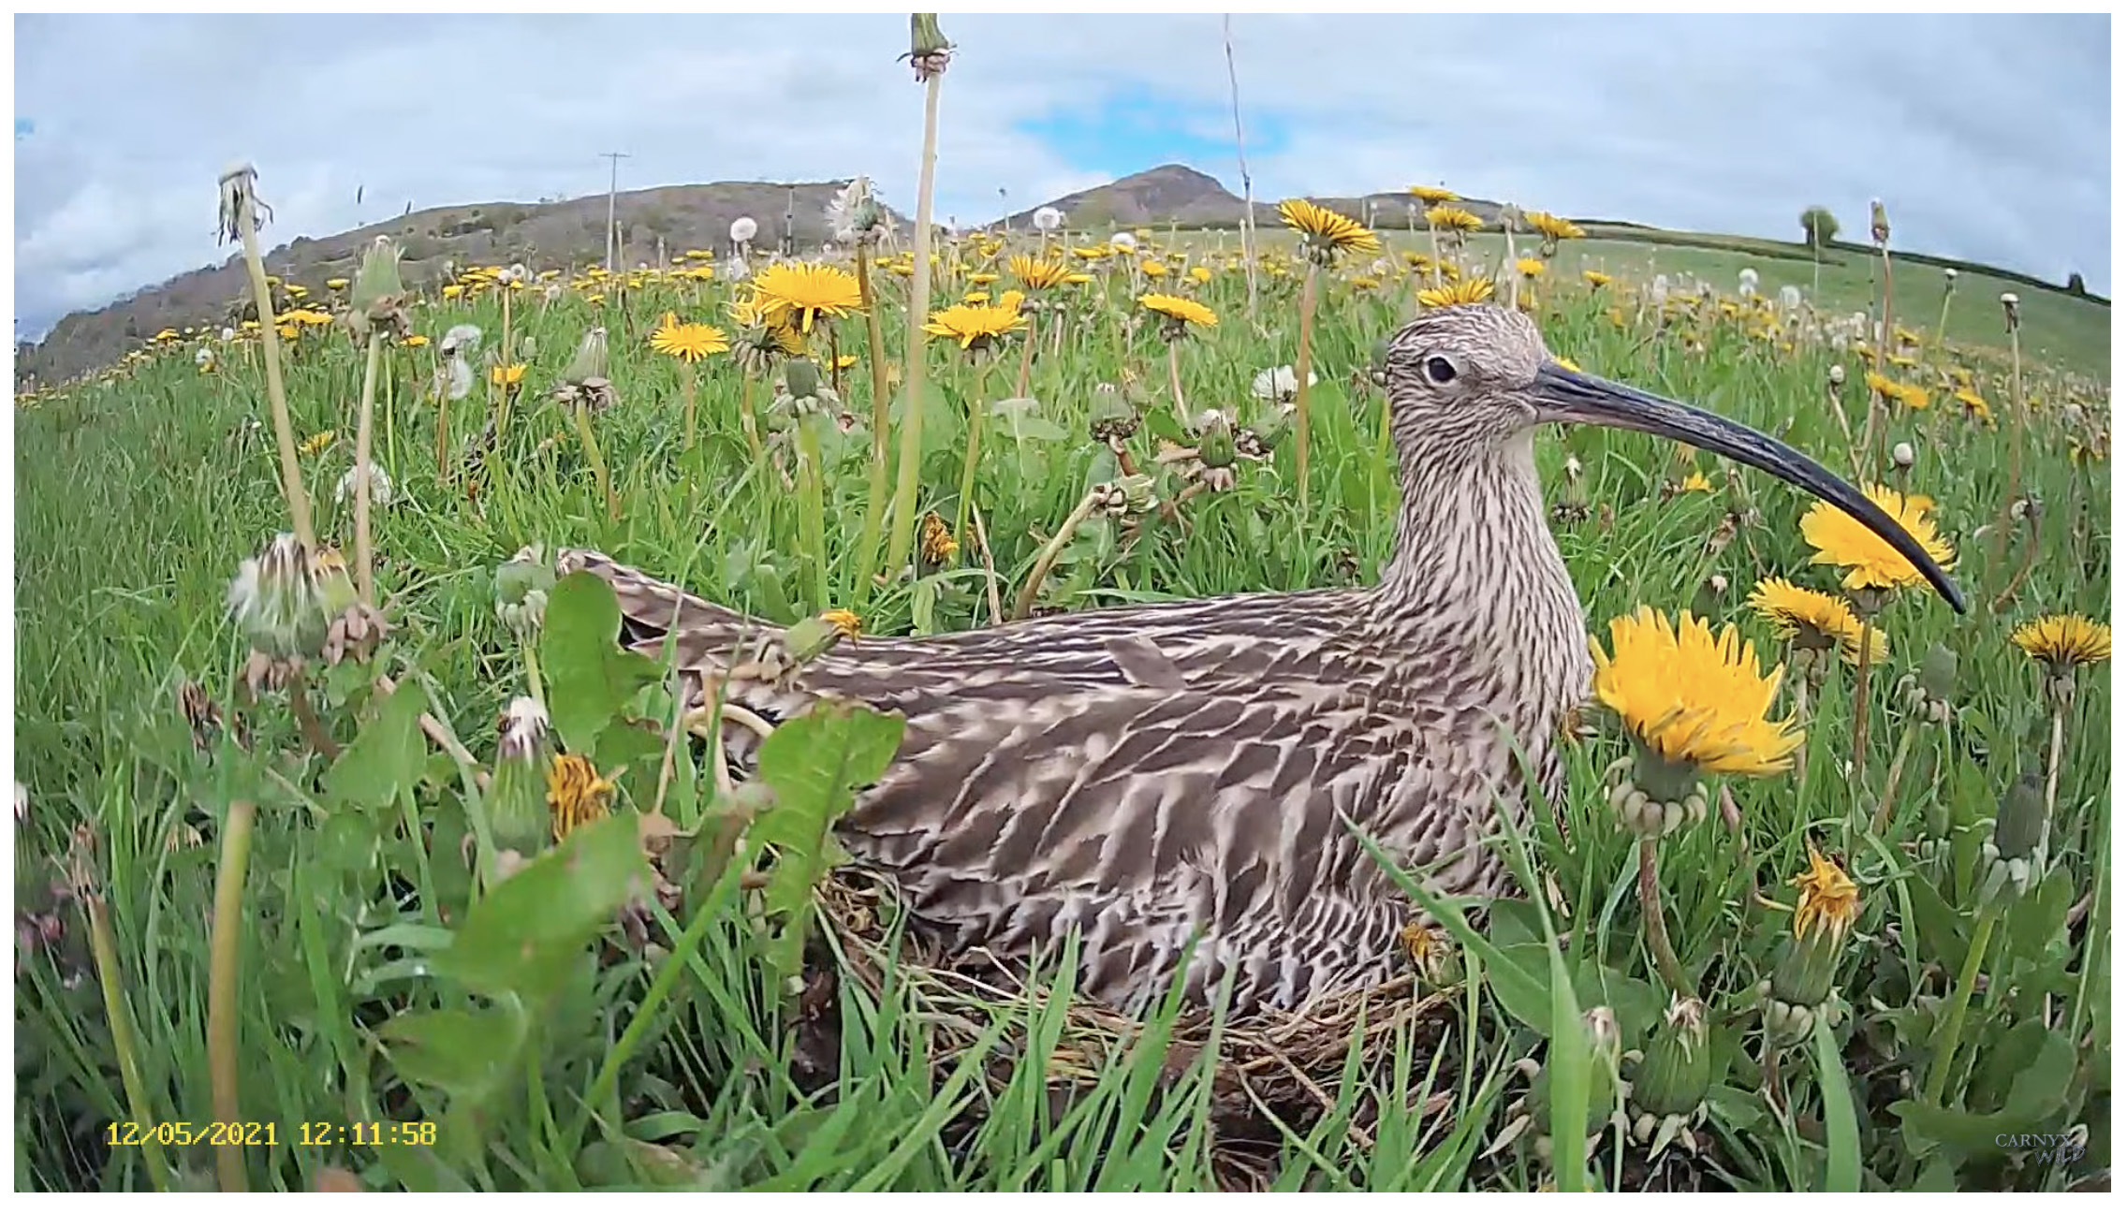
The Curlew Recovery Partnership: Engagement
CRP network already has over 210 contacts representing several hundred Curlew enthusiasts
CRP website, blog, and social media streams are live and attracting a growing audience
CRP delivered an online seminar as a contribution to World Curlew Day on 21 Apr 2021 – guest speaker videos uploaded to CRP YouTube channel
CRP is sponsoring Curlew Cam 2021, which is a live webcam of a Curlew nest co-ordinated by Curlew Country

Slide 10
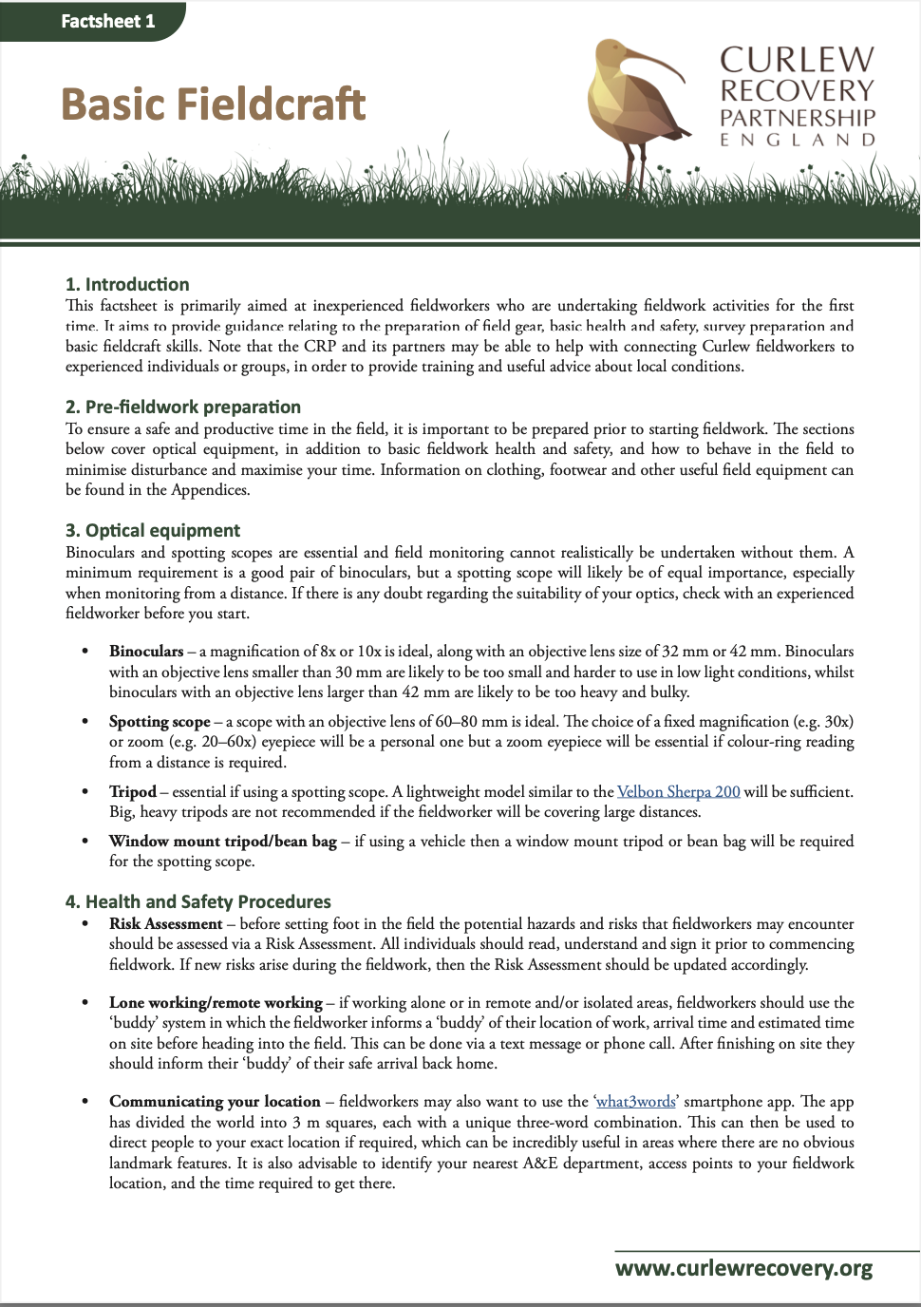
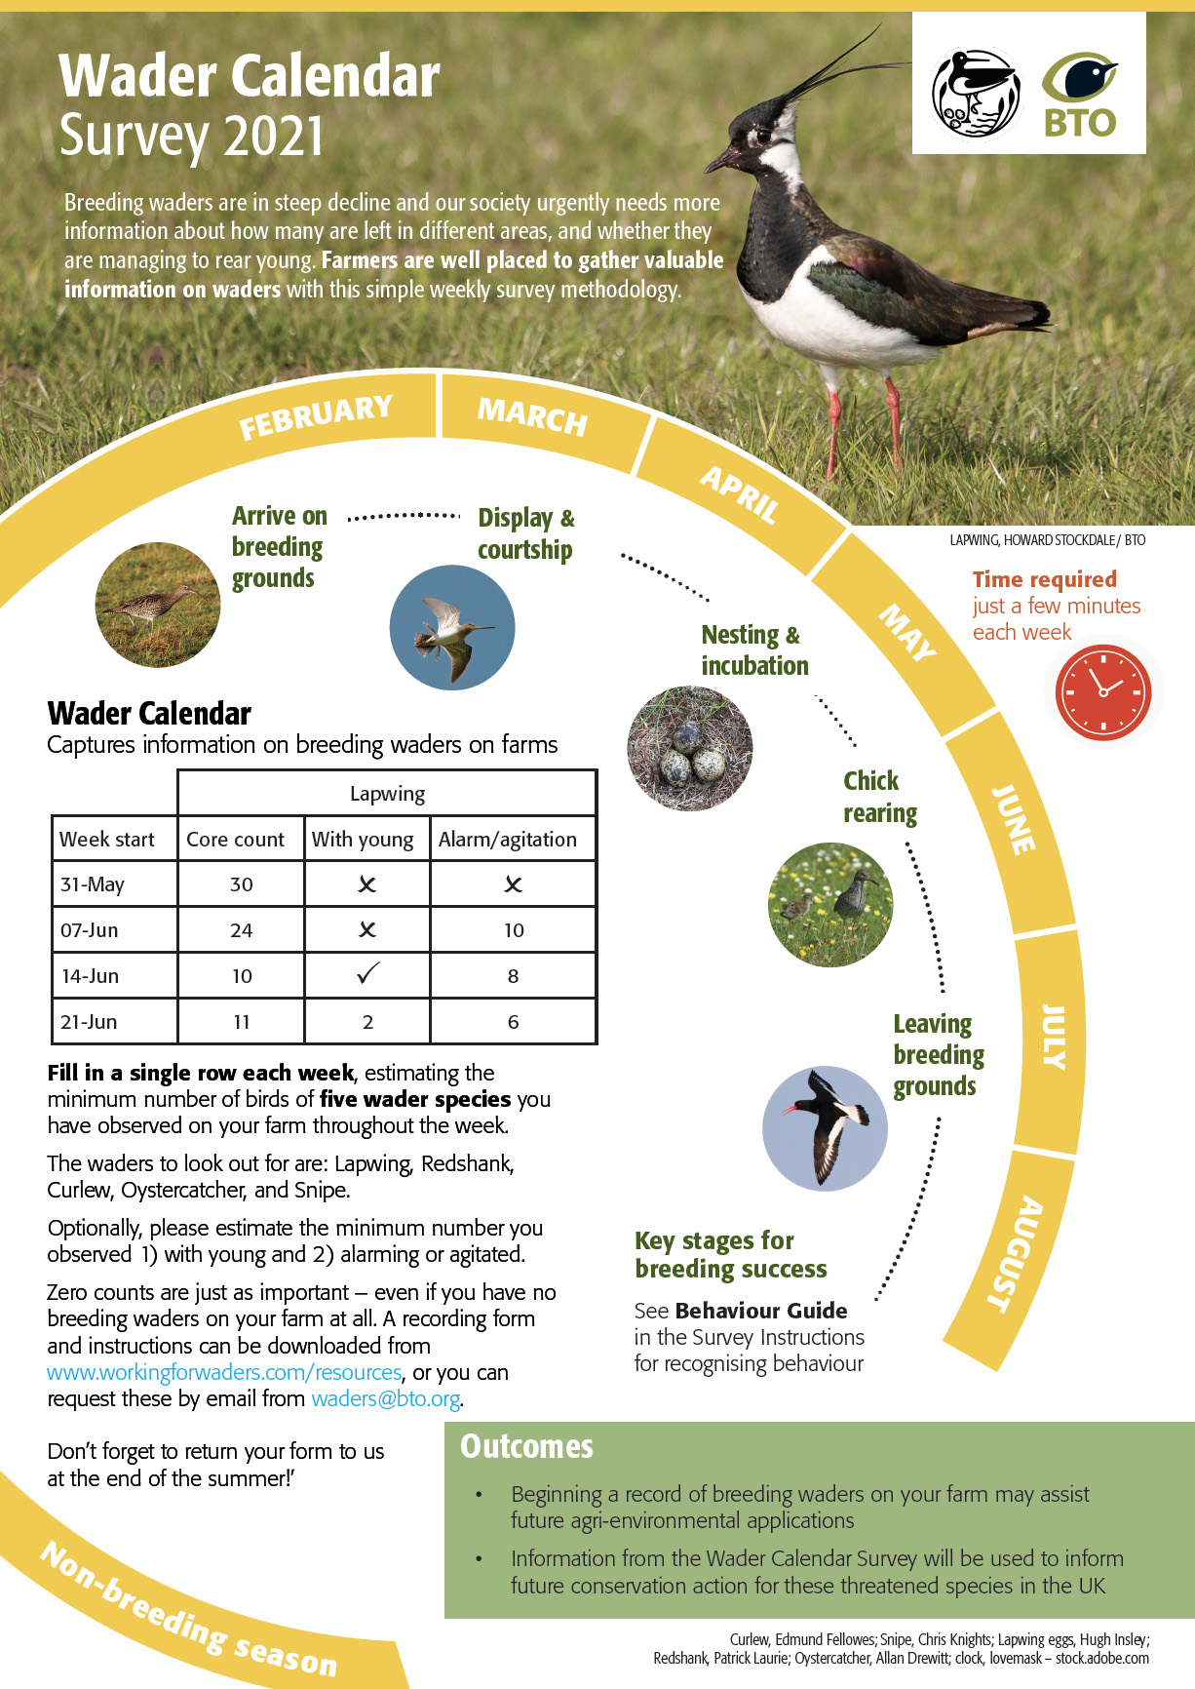
The Curlew Recovery Partnership: Resources
CRP Fieldworker Toolkit
BTO Wader Calendar

Slide 11
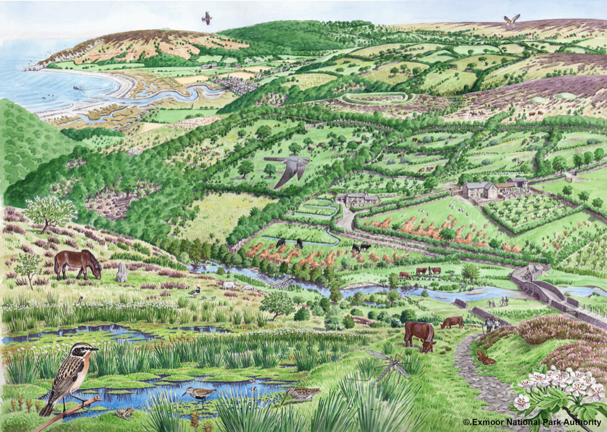
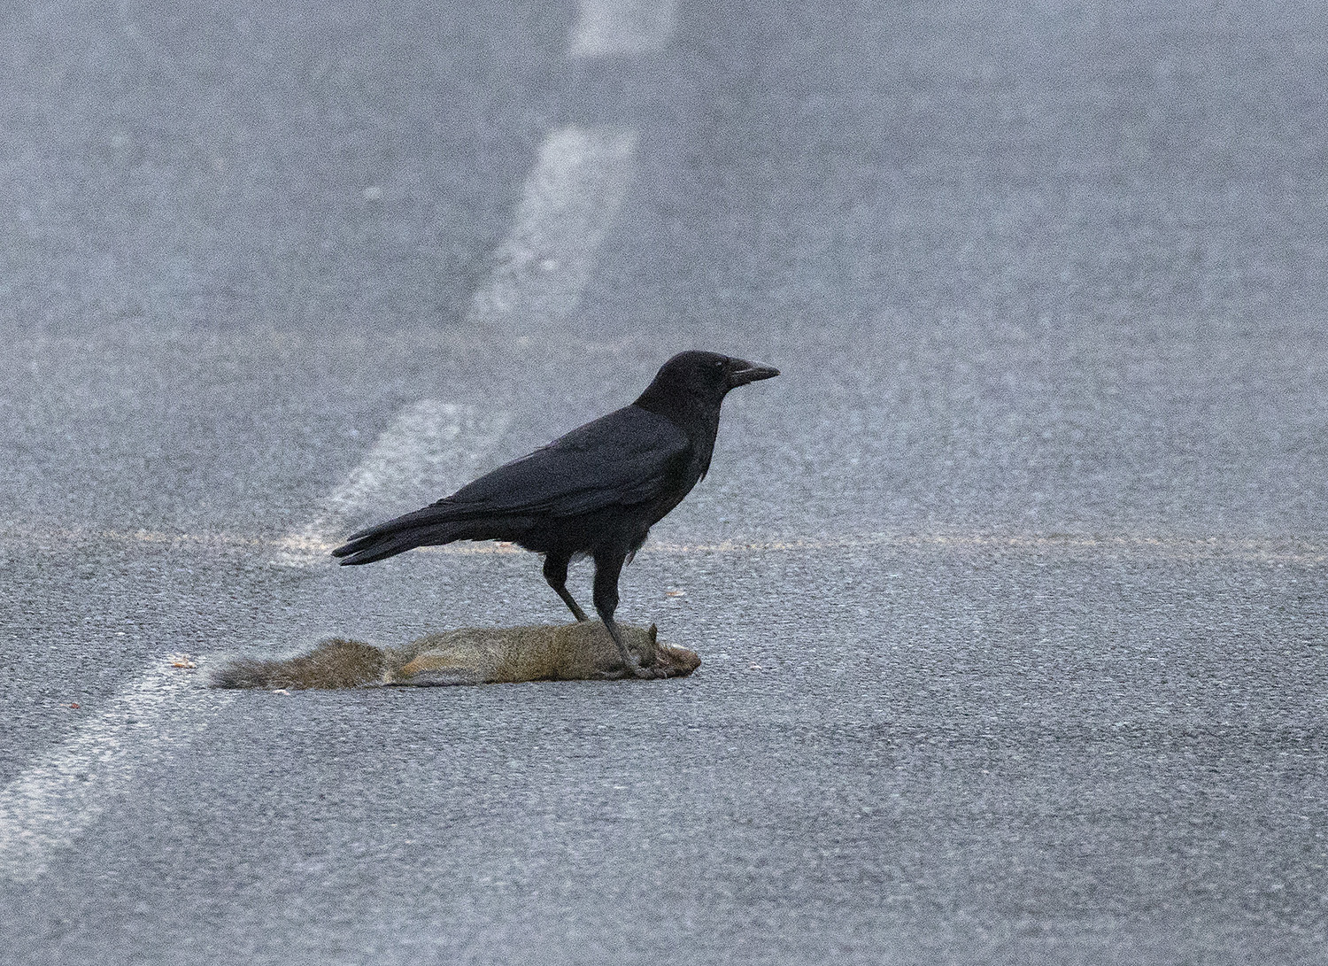
The Curlew Recovery Partnership: Future research
The CRP will be developing a future work programme in the coming months, with a strong focus on how habitat and landscape factors influence wader populations, food availability, and distribution and abundance of key predators – key questions may include:
What methods should we use for consistent and accurate monitoring of Curlews?
How can future Agri-Environment Schemes be designed to improve outcomes for Curlews?
How can we quantify the value of ecosystem services resulting from ‘Curlew-friendly’ farming?
Why does the UK have the highest mesopredator densities in Europe, e.g. Foxes and Carrion Crows?
What mechanisms are most effective in reducing recreational disturbance, e.g. signs vs fines?
How do we retain sufficient coastal habitat for Curlews under long-term sea-level rise scenarios?

Slide 12
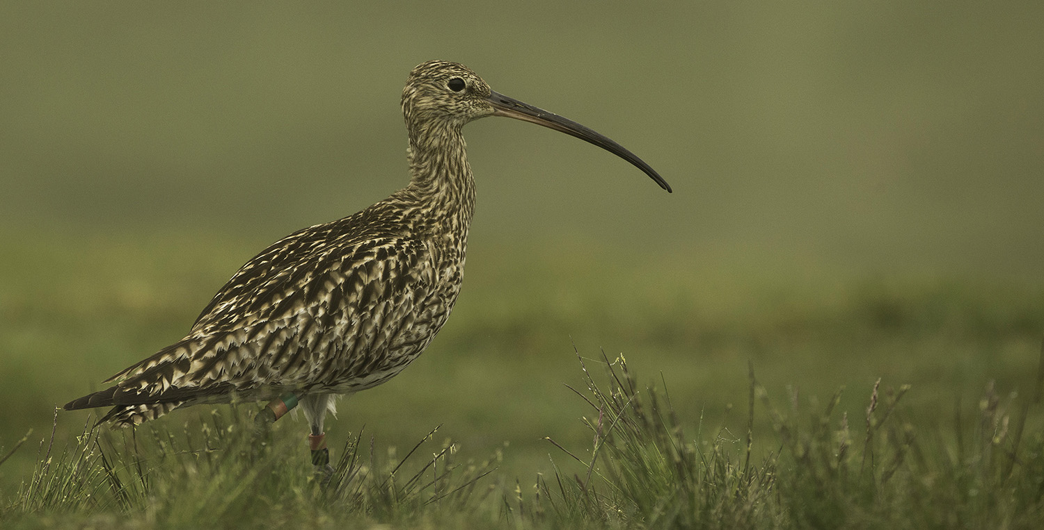
The Curlew Recovery Partnership: Join our network
Photo: Tom Streeter
Email: hello@curlewrecovery.org
Website: www.curlewrecovery.org

