Slide 1
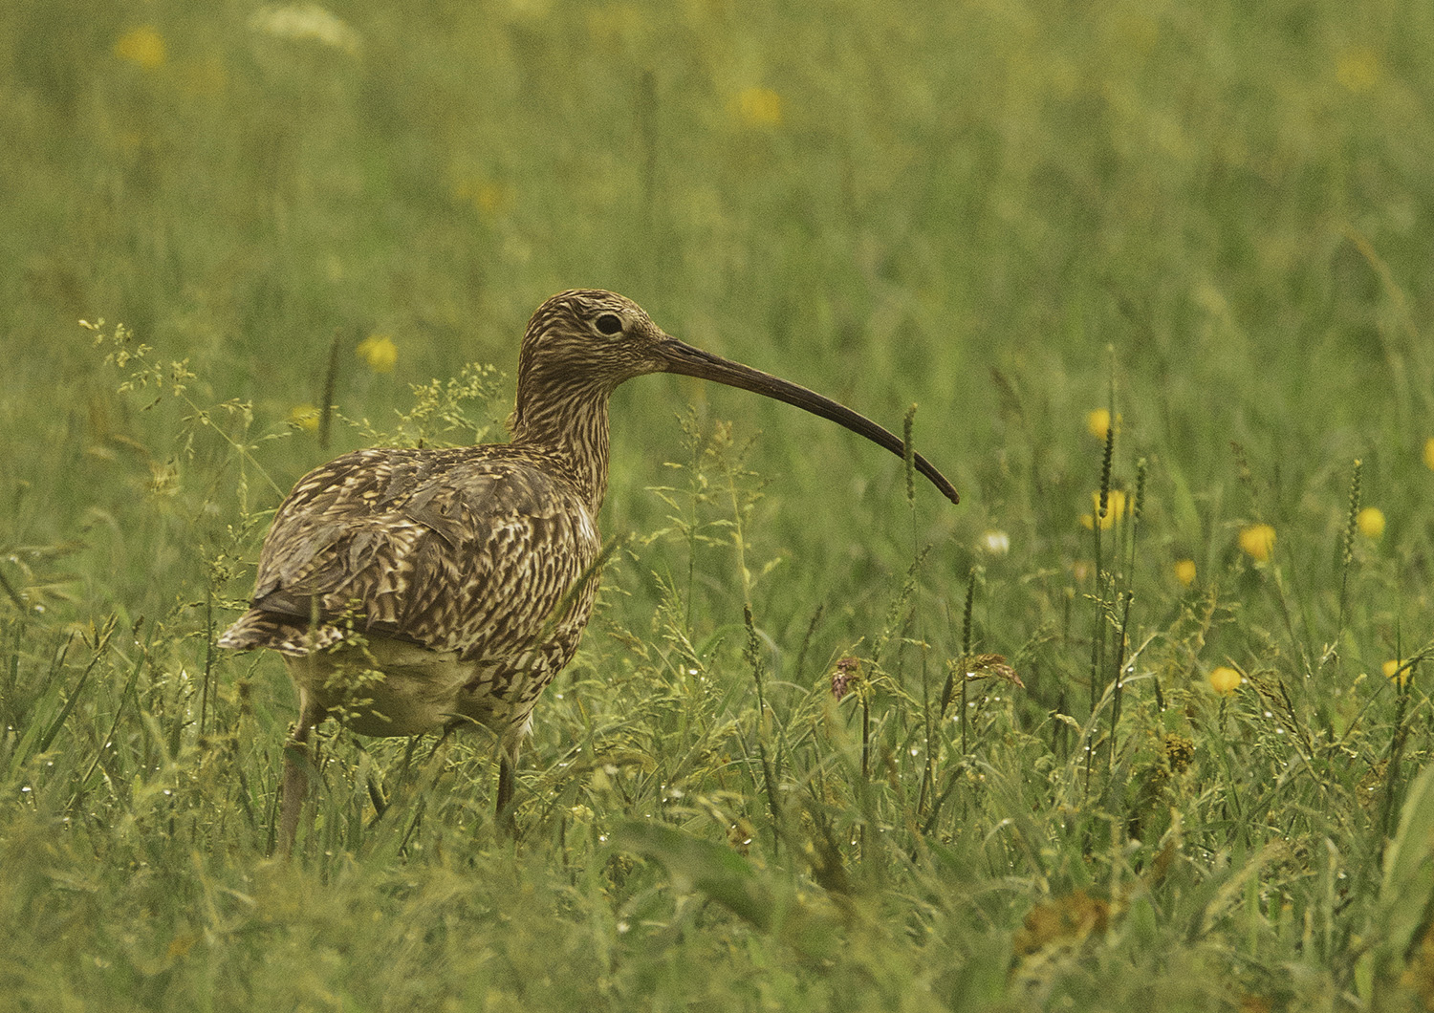
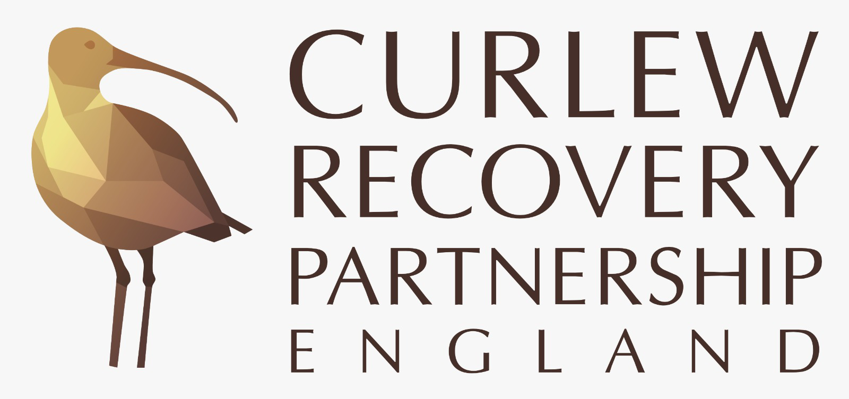
Introducing Curlews and the Curlew Recovery Partnership
Photo: Tom Streeter

Slide 2
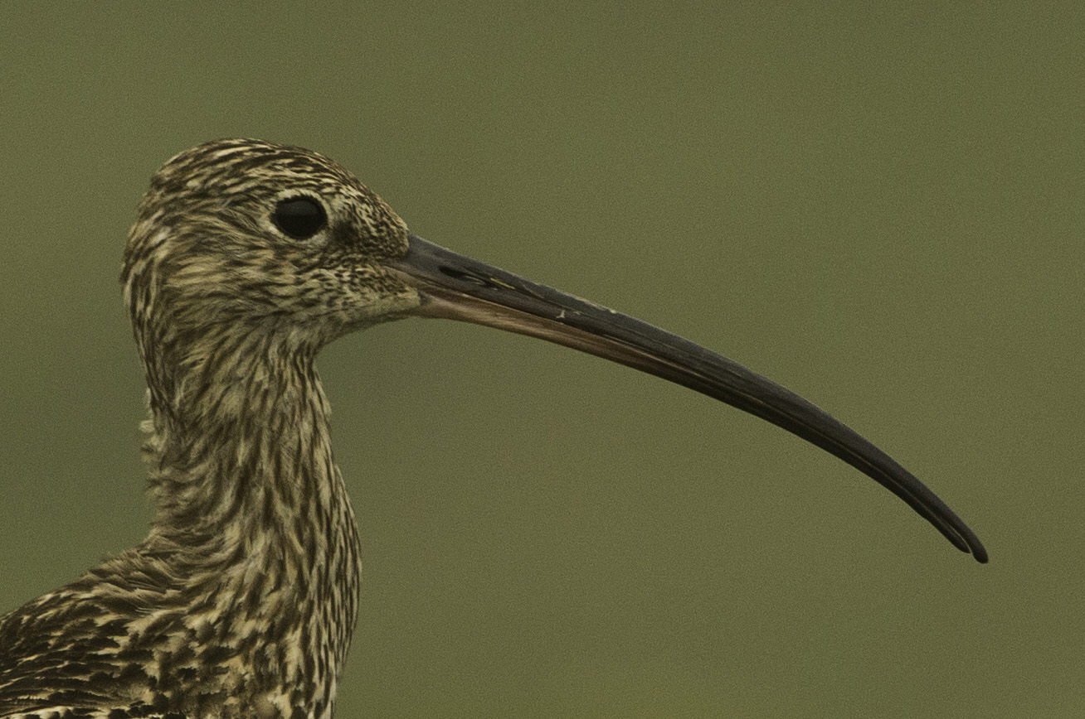
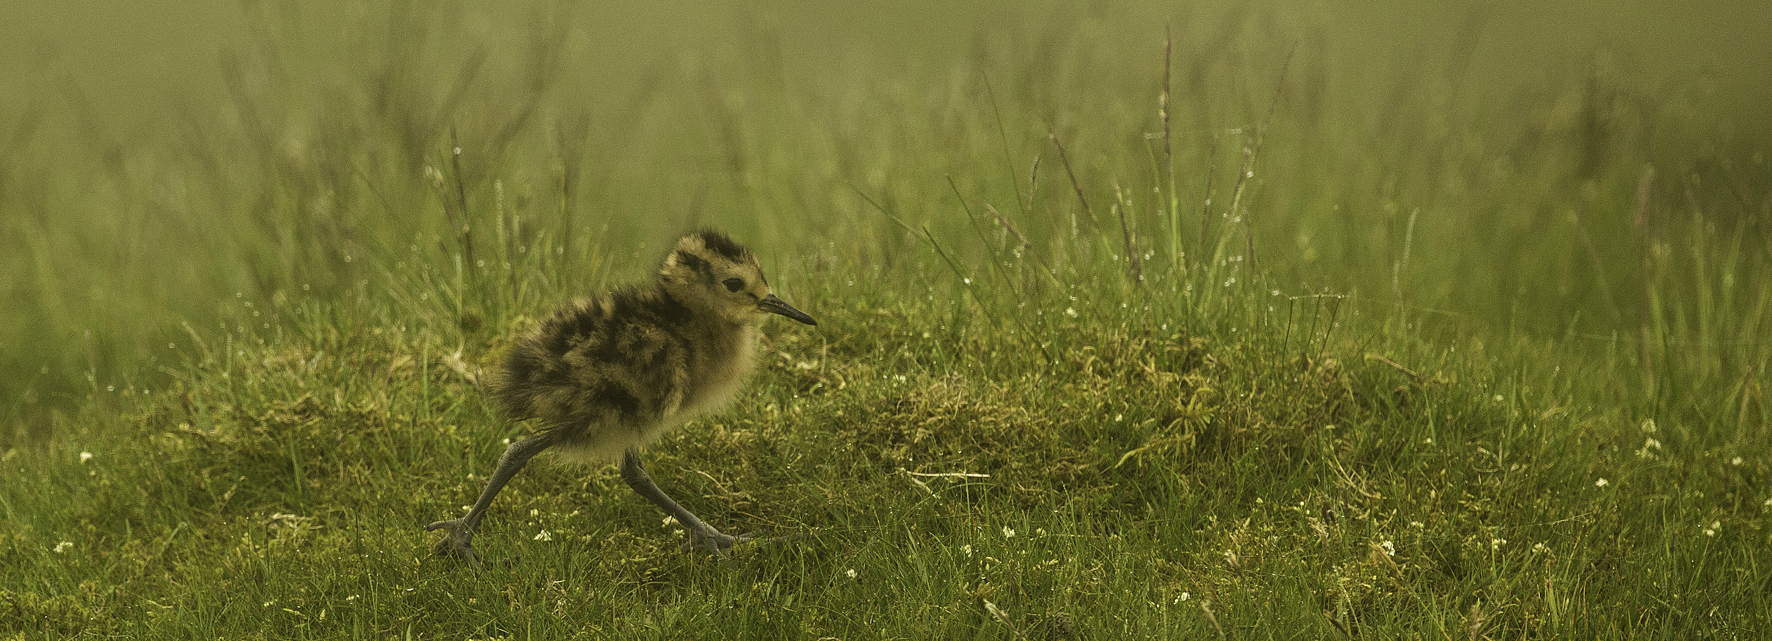
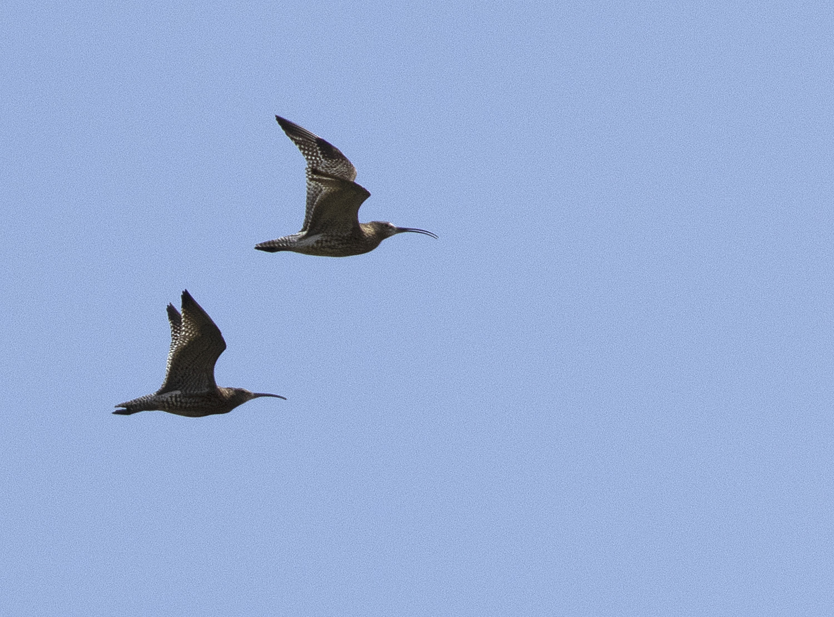
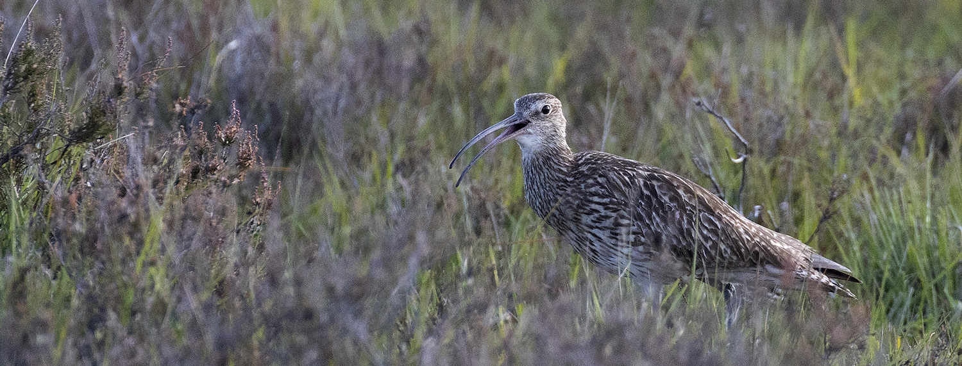
The Eurasian Curlew: Ecology
Photo: Tom Streeter
Photo: Andy Page
Photo: Tom Streeter
Female
Male

Slide 3
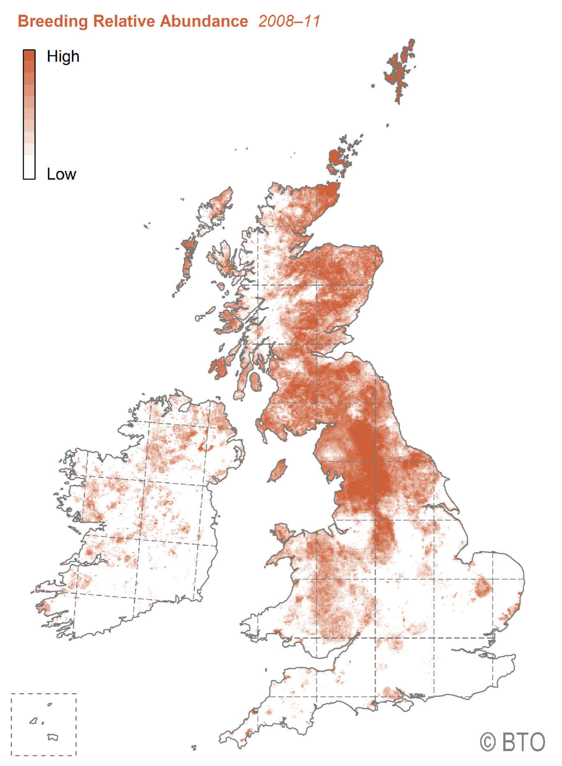
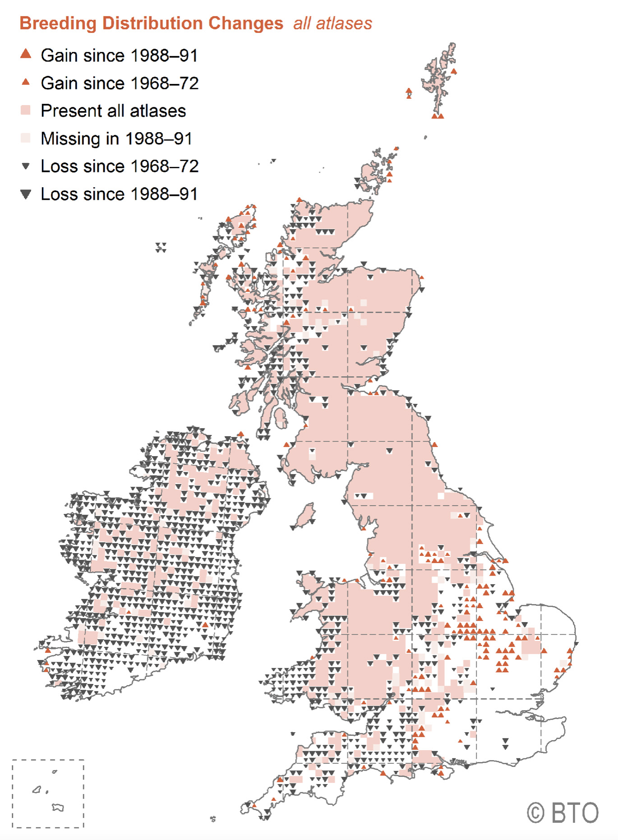
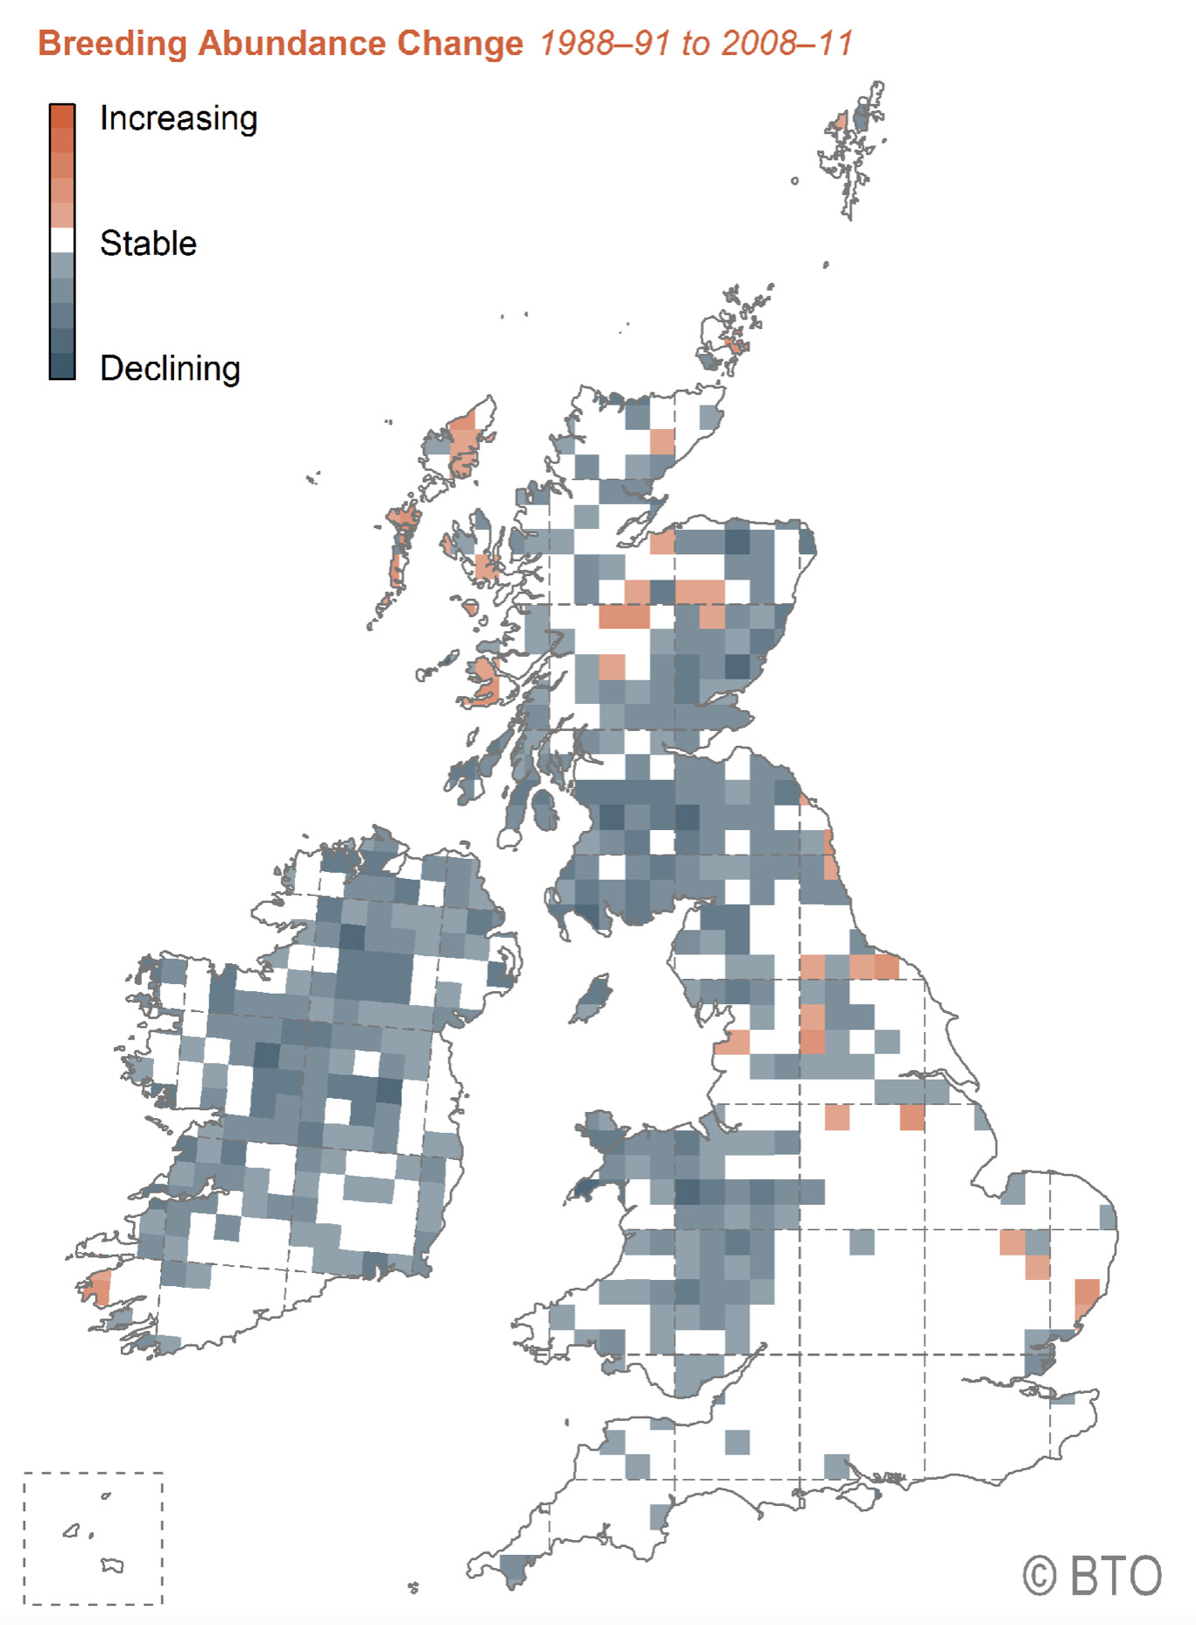
The Eurasian Curlew: Distribution and status
This map shows that Curlews have been lost from much of Ireland and western and lowland UK
Highest abundance in the Pennines
Possibly as few as 2000 pairs remain south of the black line
This map shows that Curlews are declining in abundance across most of their remaining range

Slide 4
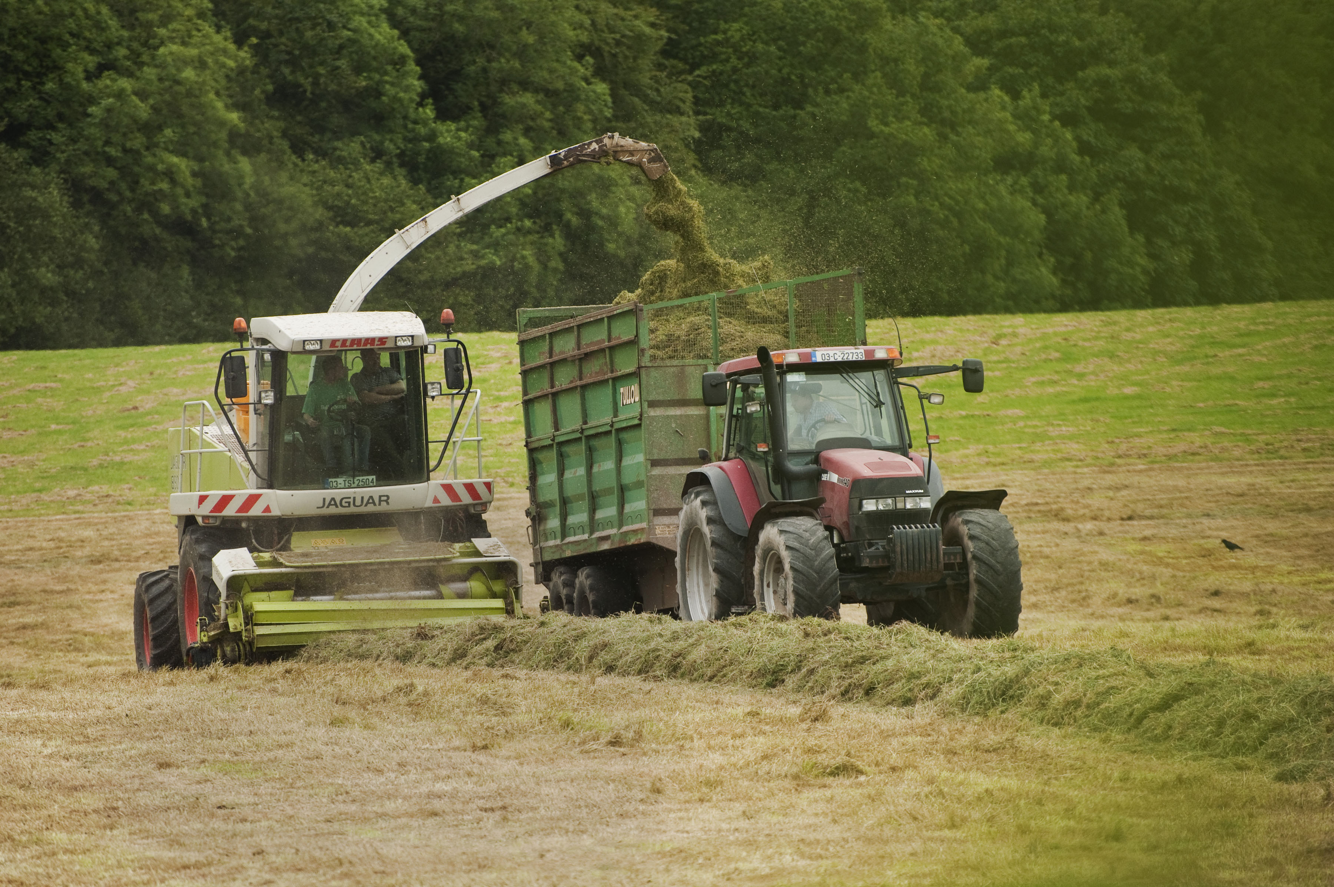
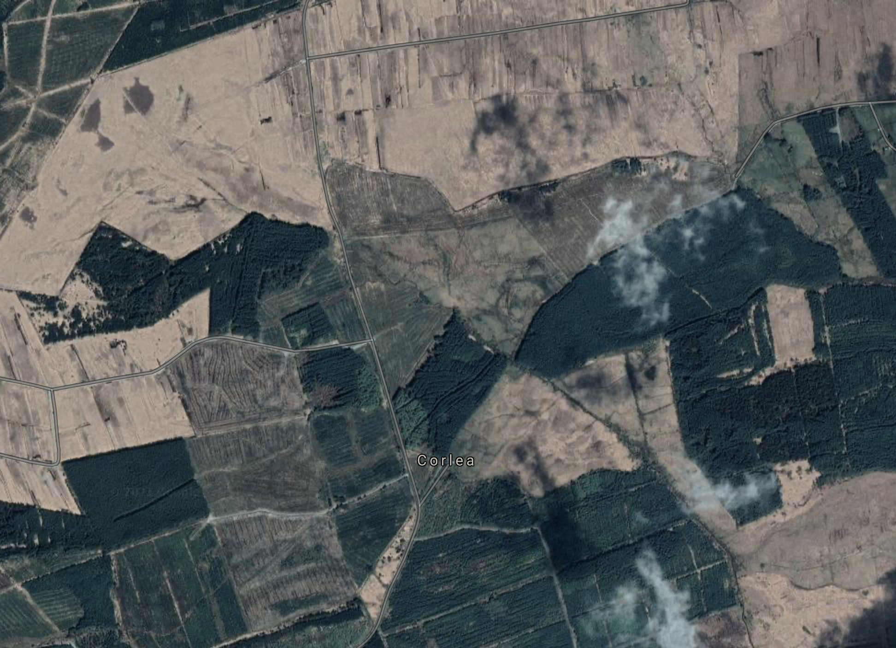
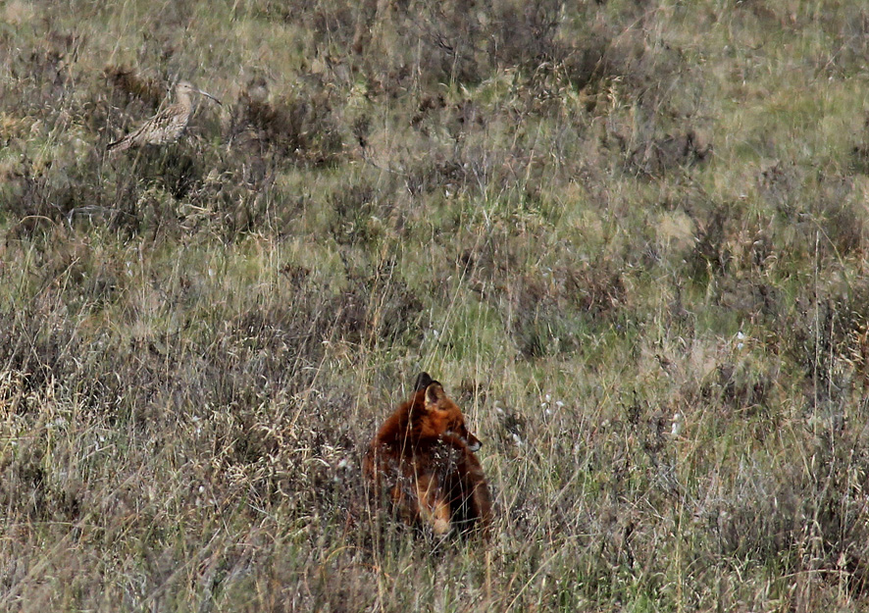
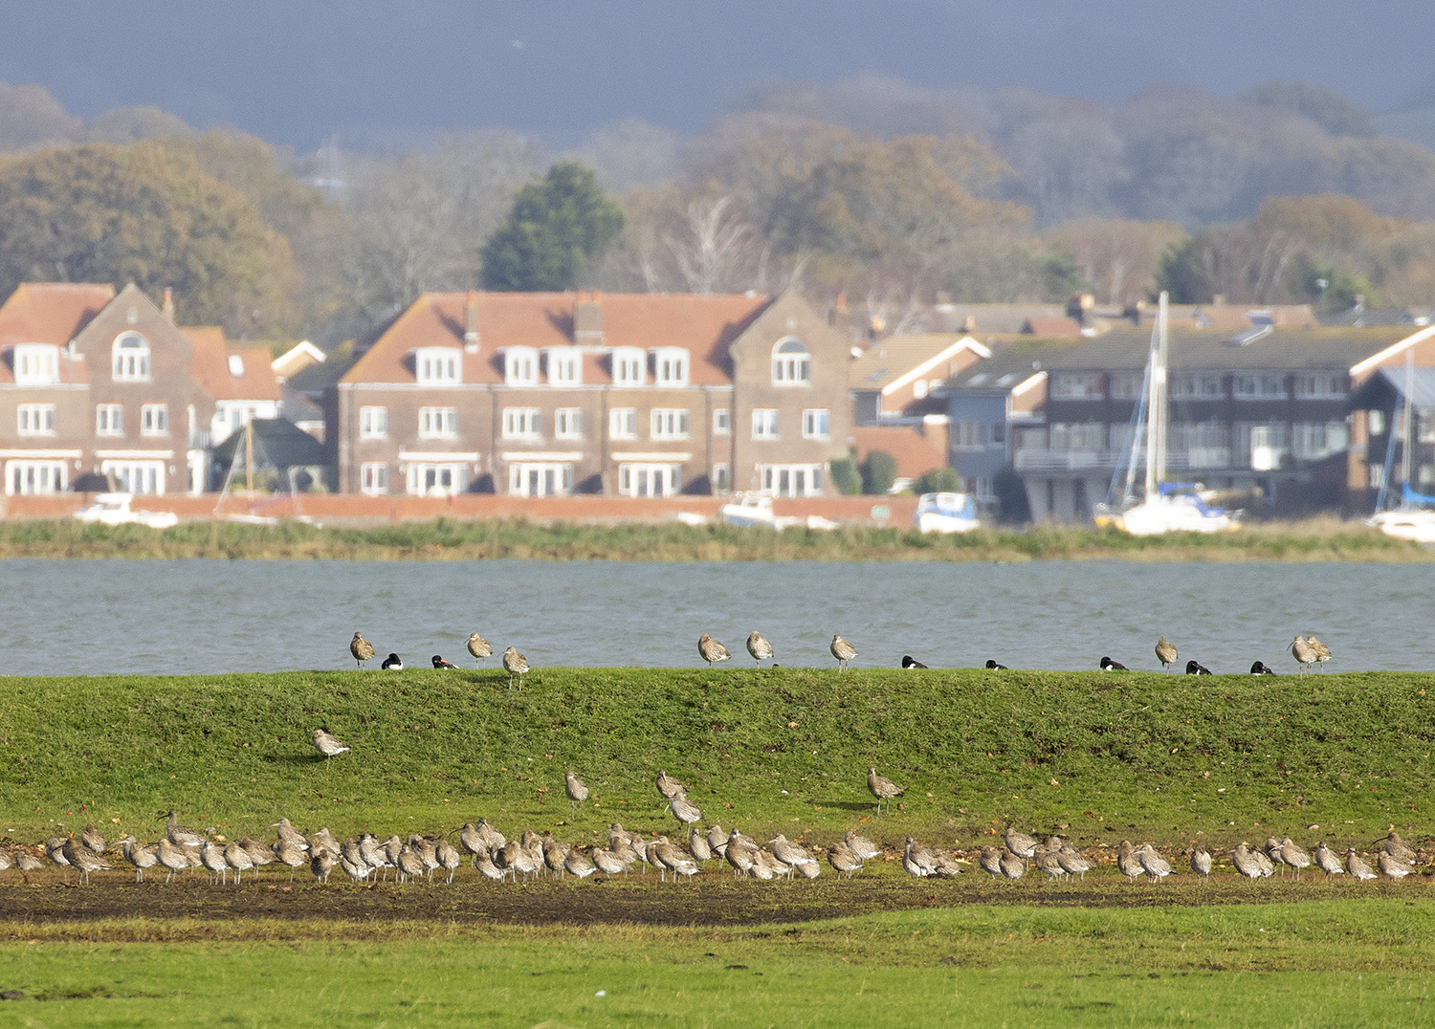
The Eurasian Curlew: Threats

Slide 5
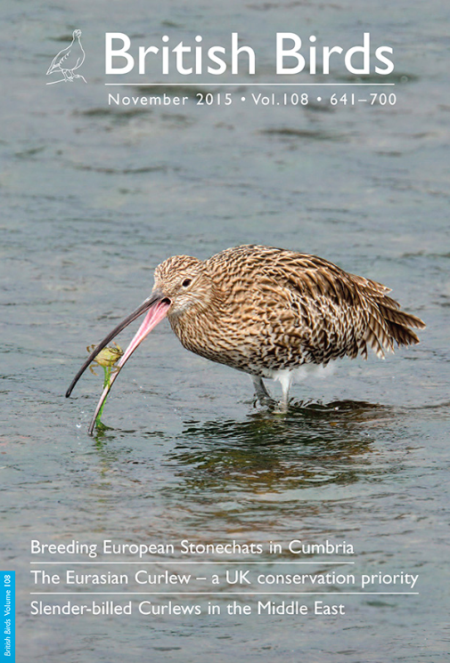
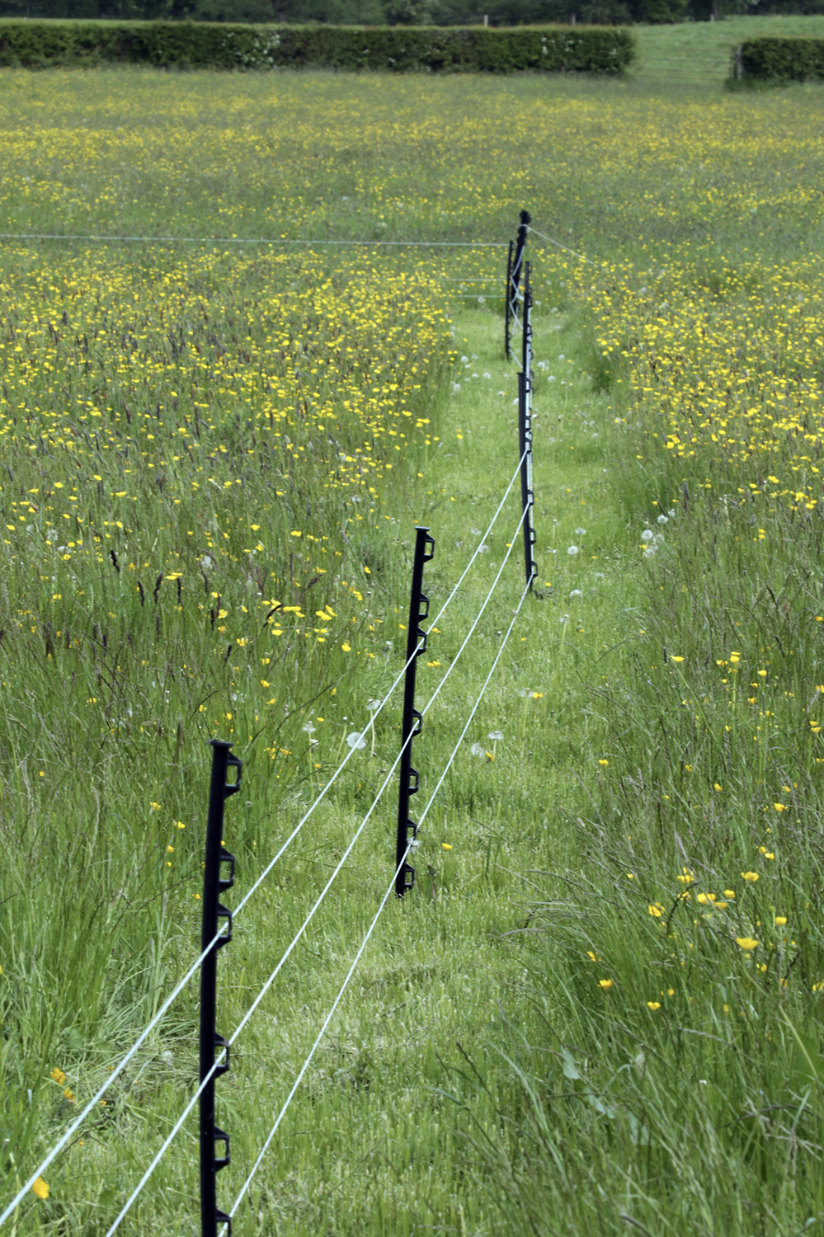
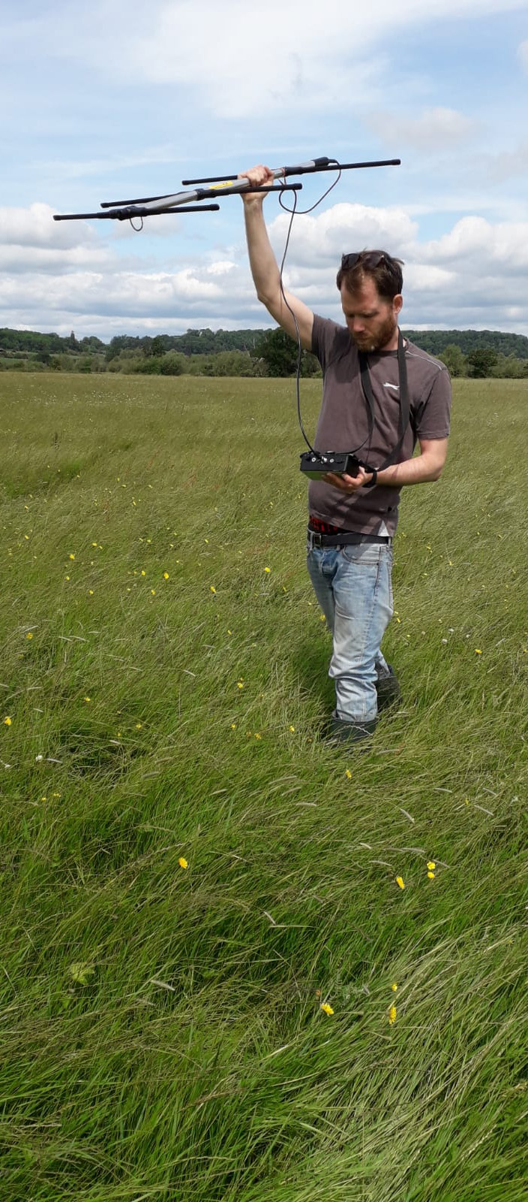
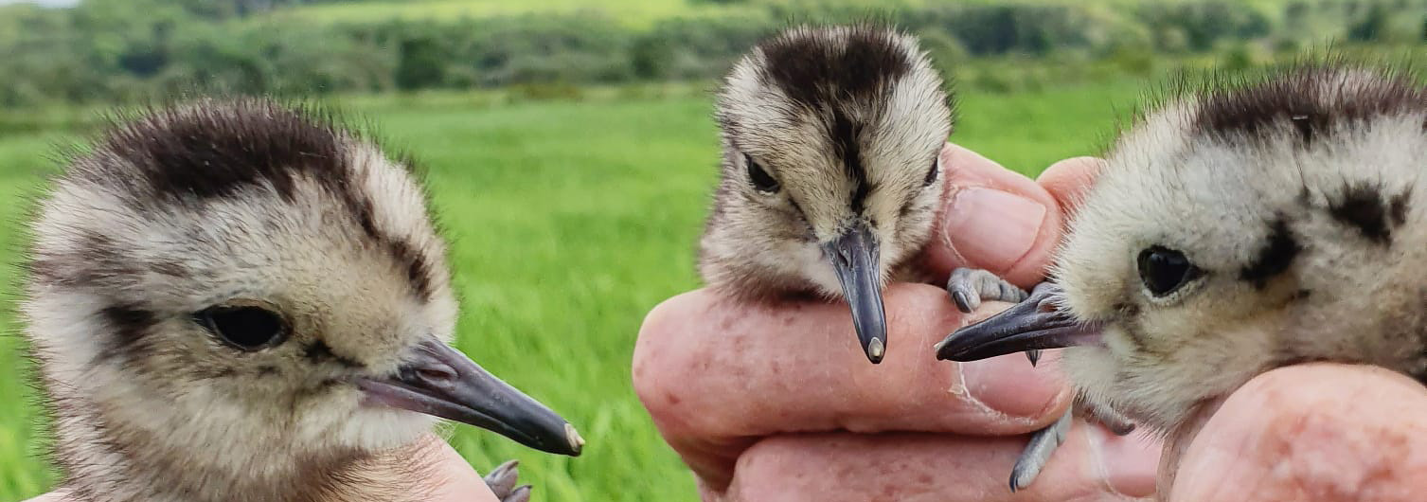
The Eurasian Curlew: Conservation action
Photo: WWT
Photo: WWT

Slide 6
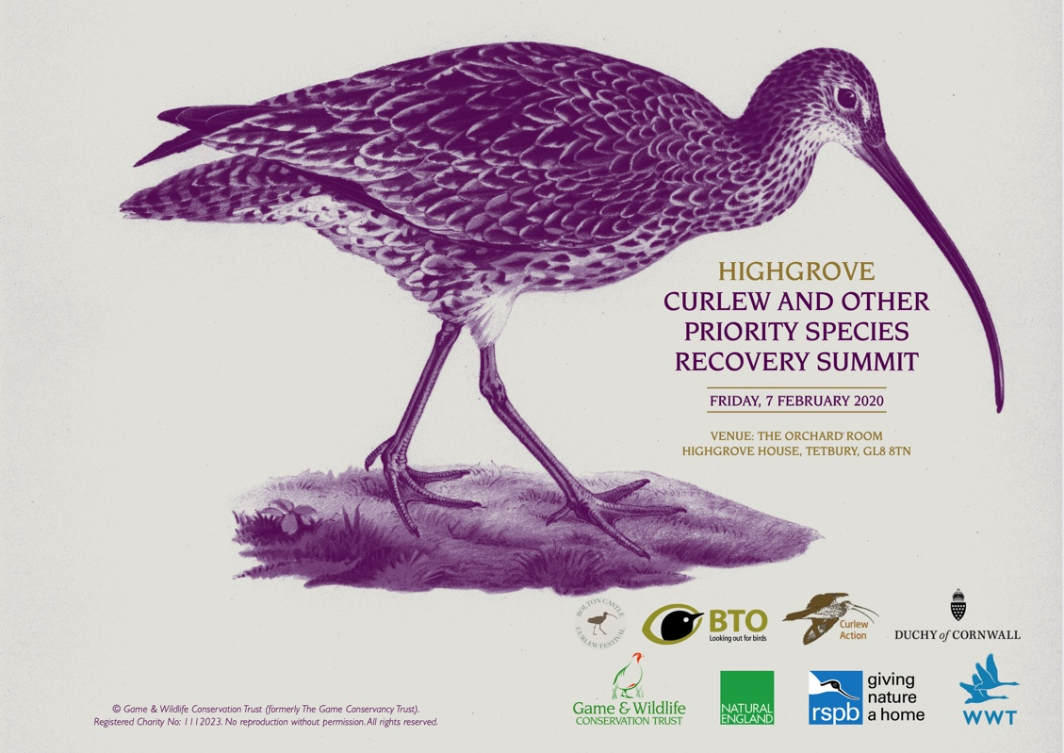
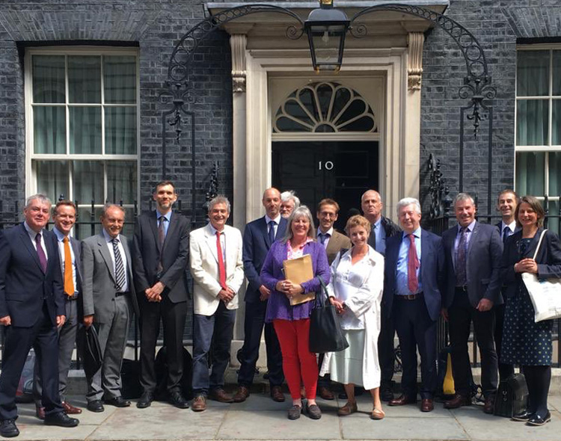
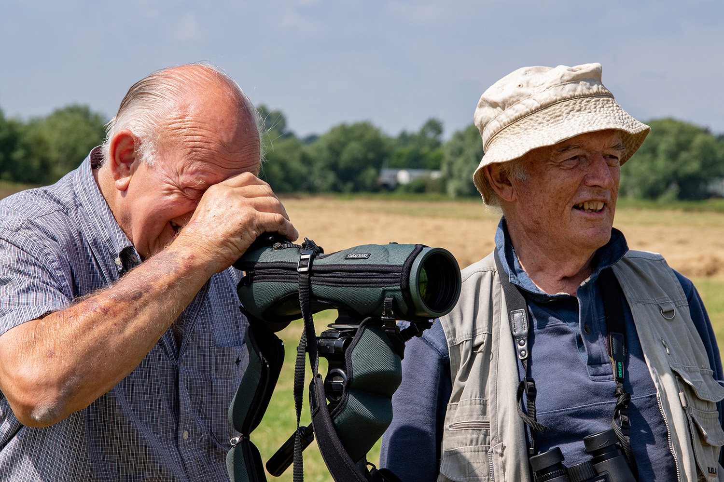
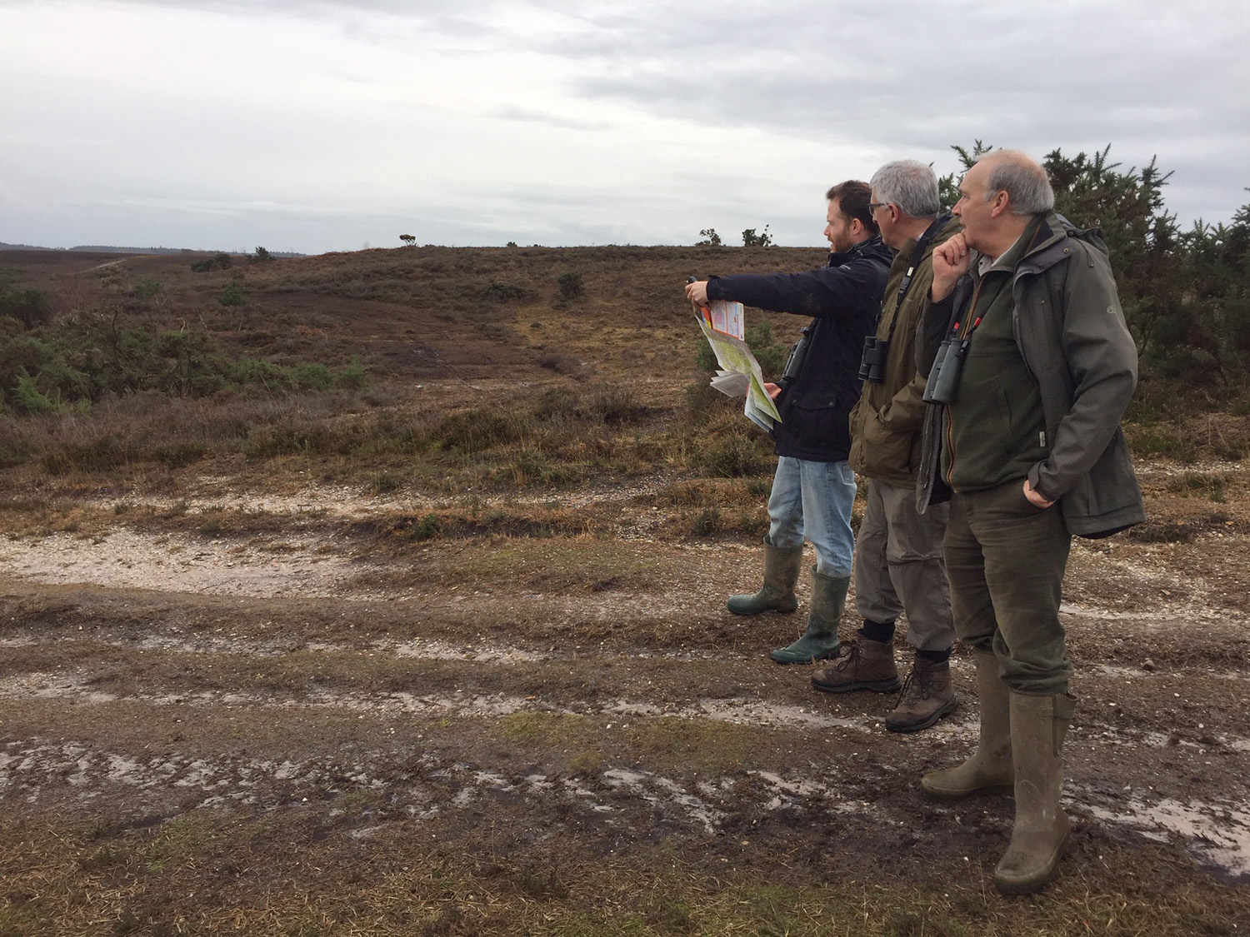
The Curlew Recovery Partnership: Origin and aims
Photo: WWT

Slide 7
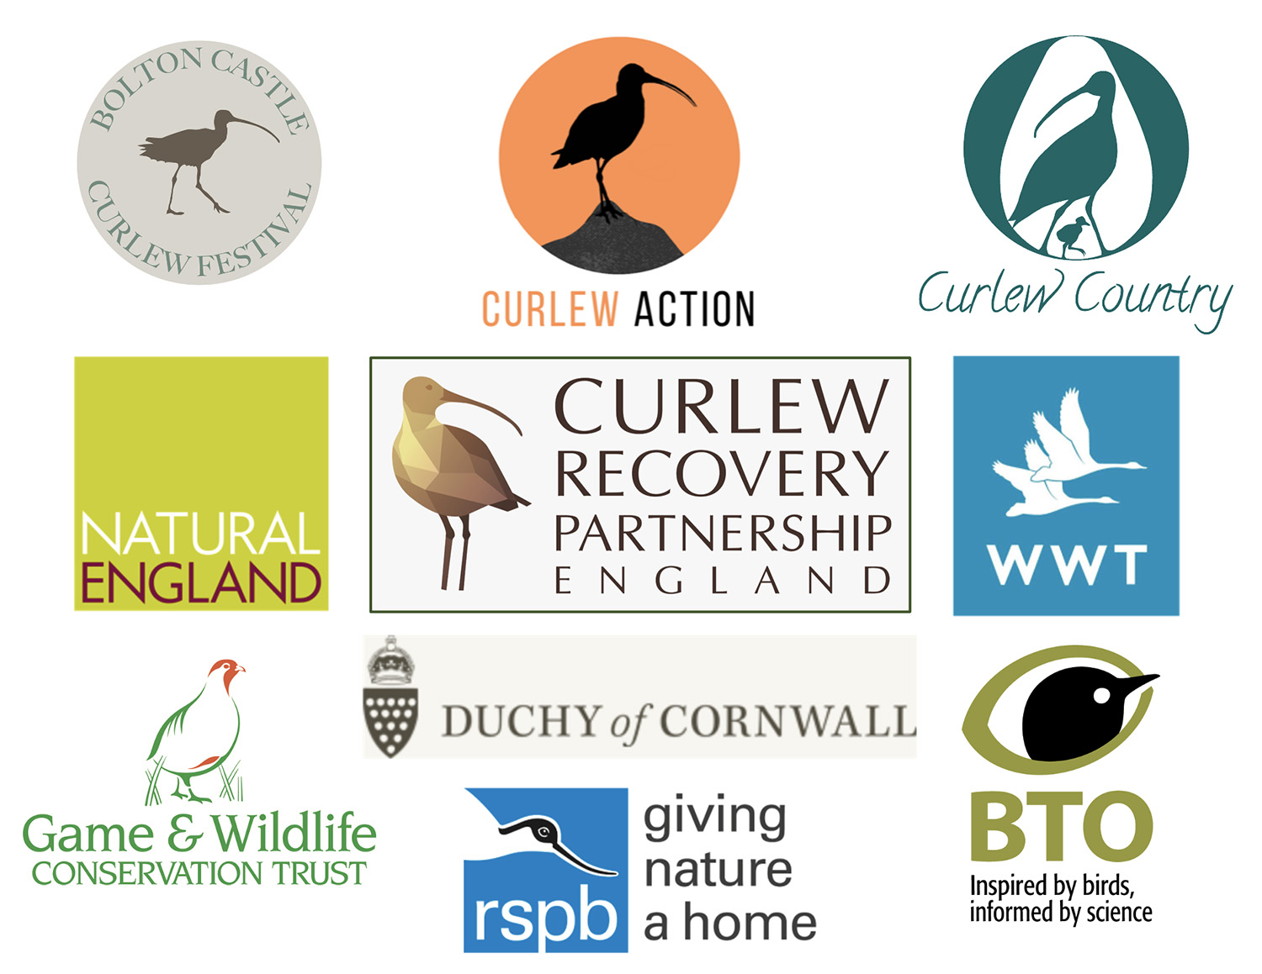
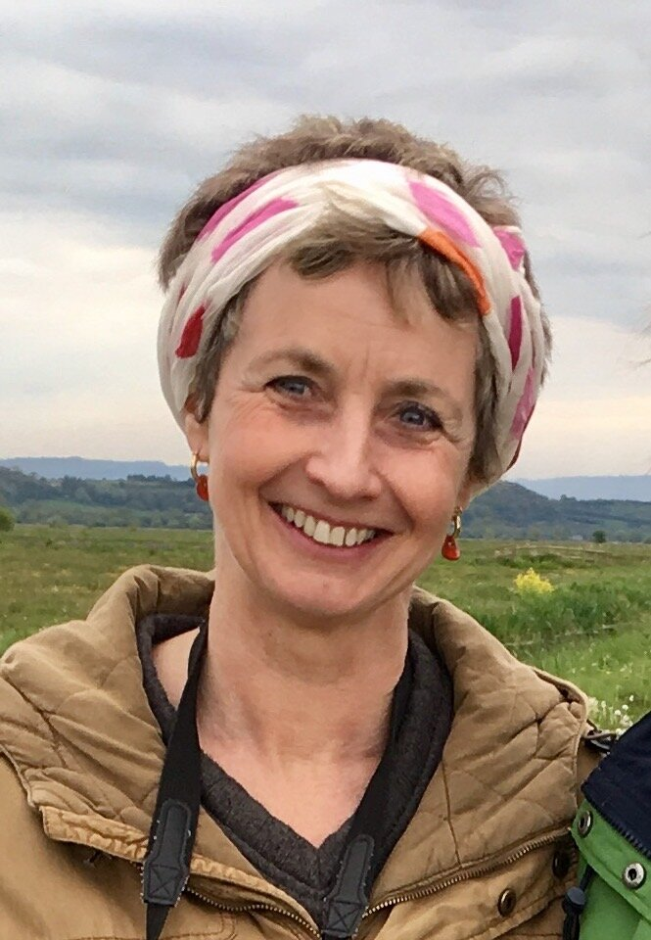
The Curlew Recovery Partnership: Steering Group
CRP Steering Group comprises nine organisations
that represent a wide range of interests in Curlew conservation
Chair
Mary Colwell
Manager
Prof Russell Wynn

Slide 8
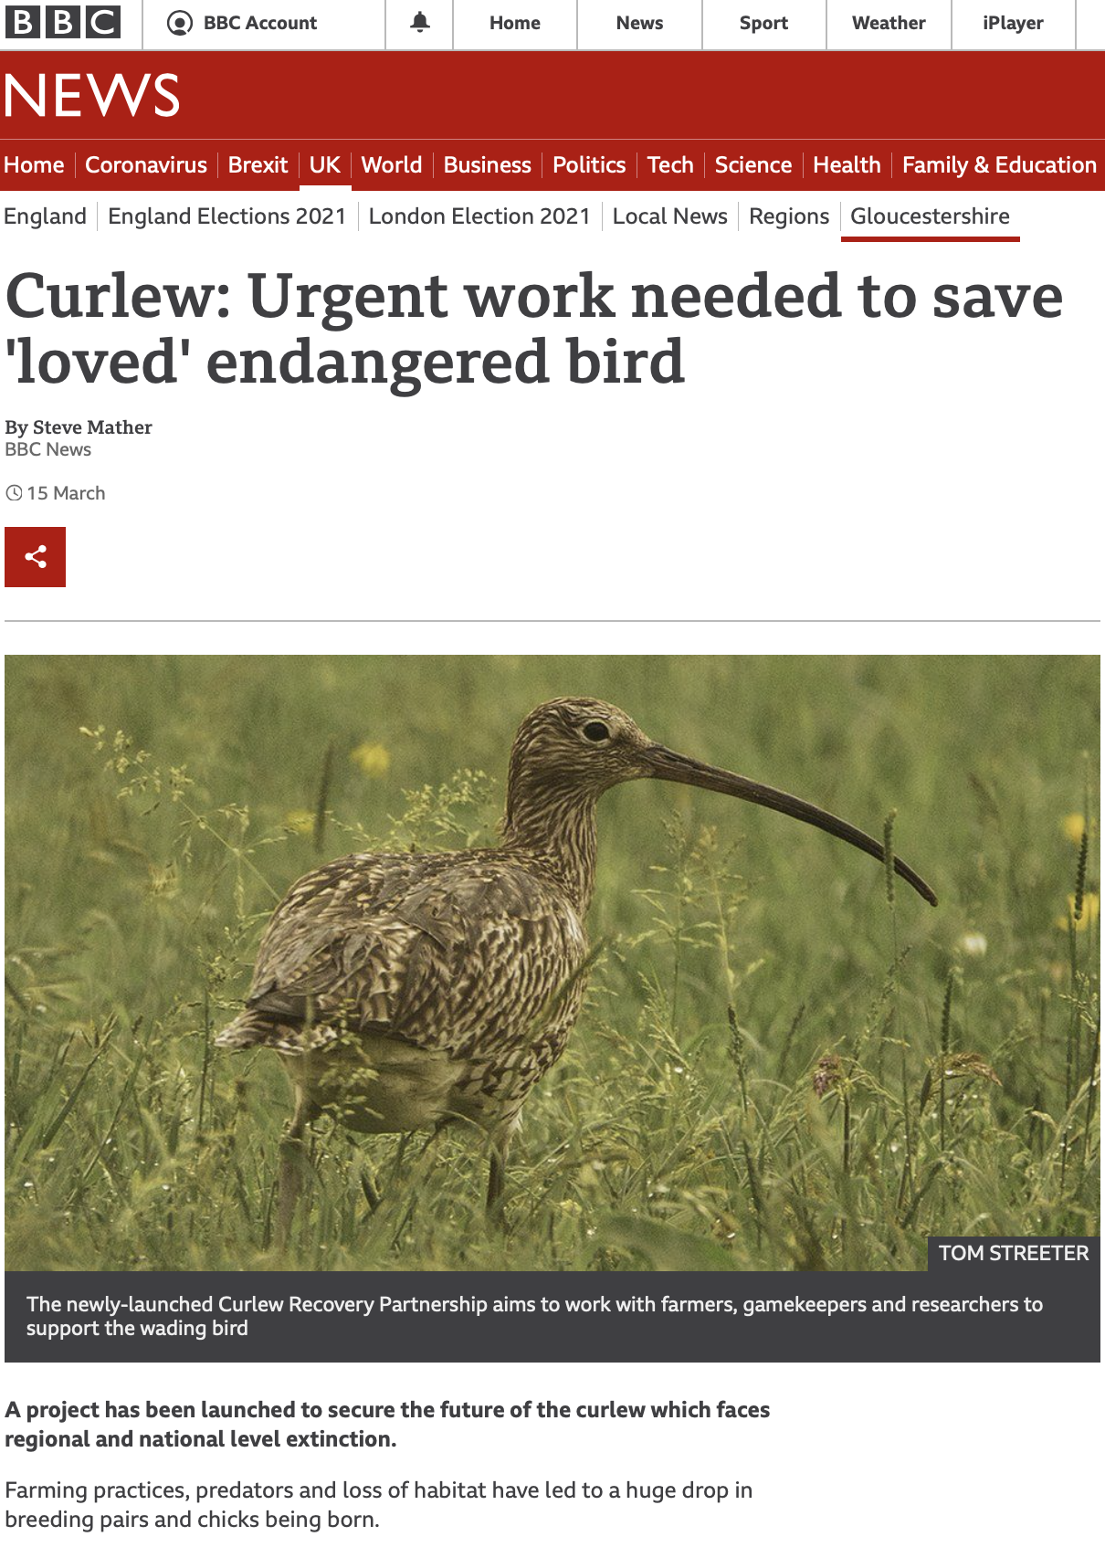
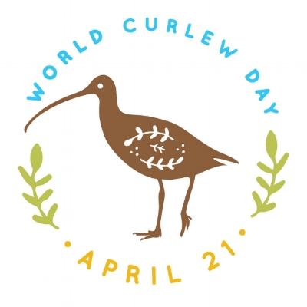
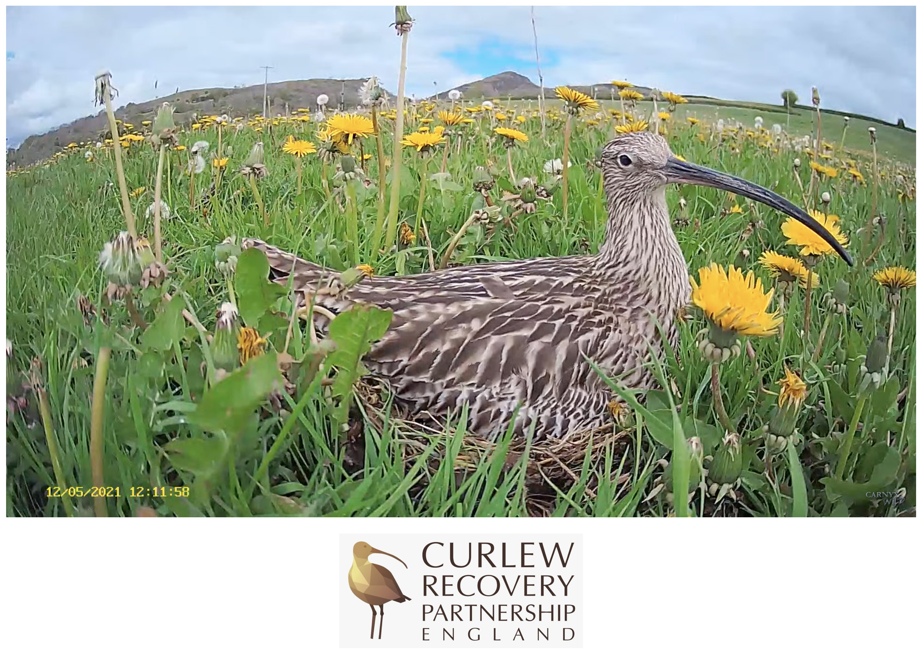
The Curlew Recovery Partnership: Engagement

Slide 9
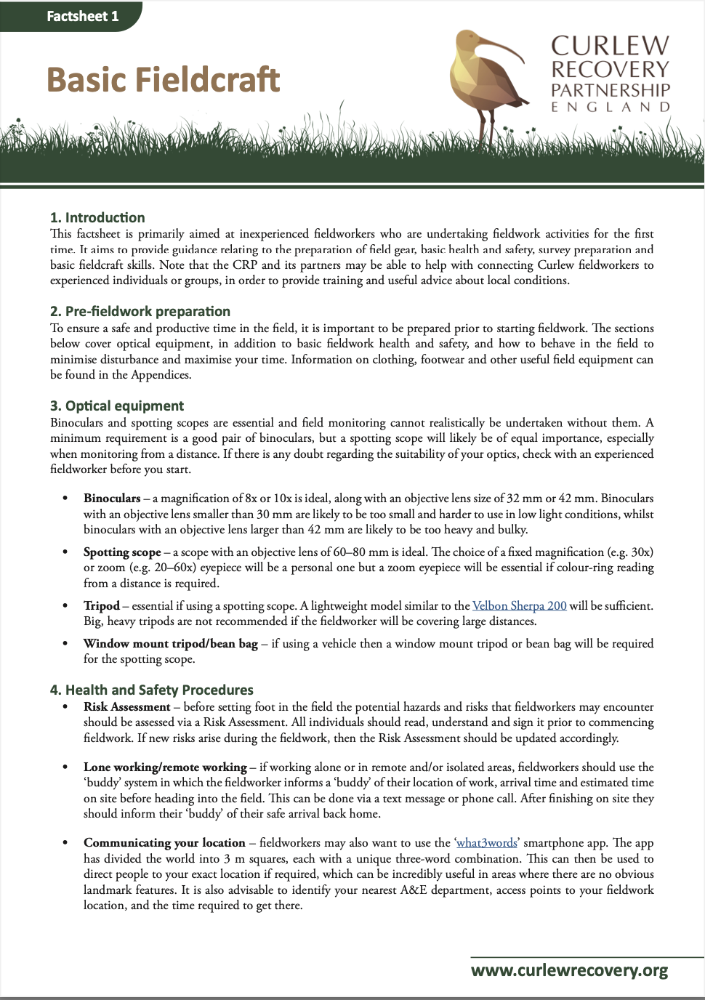
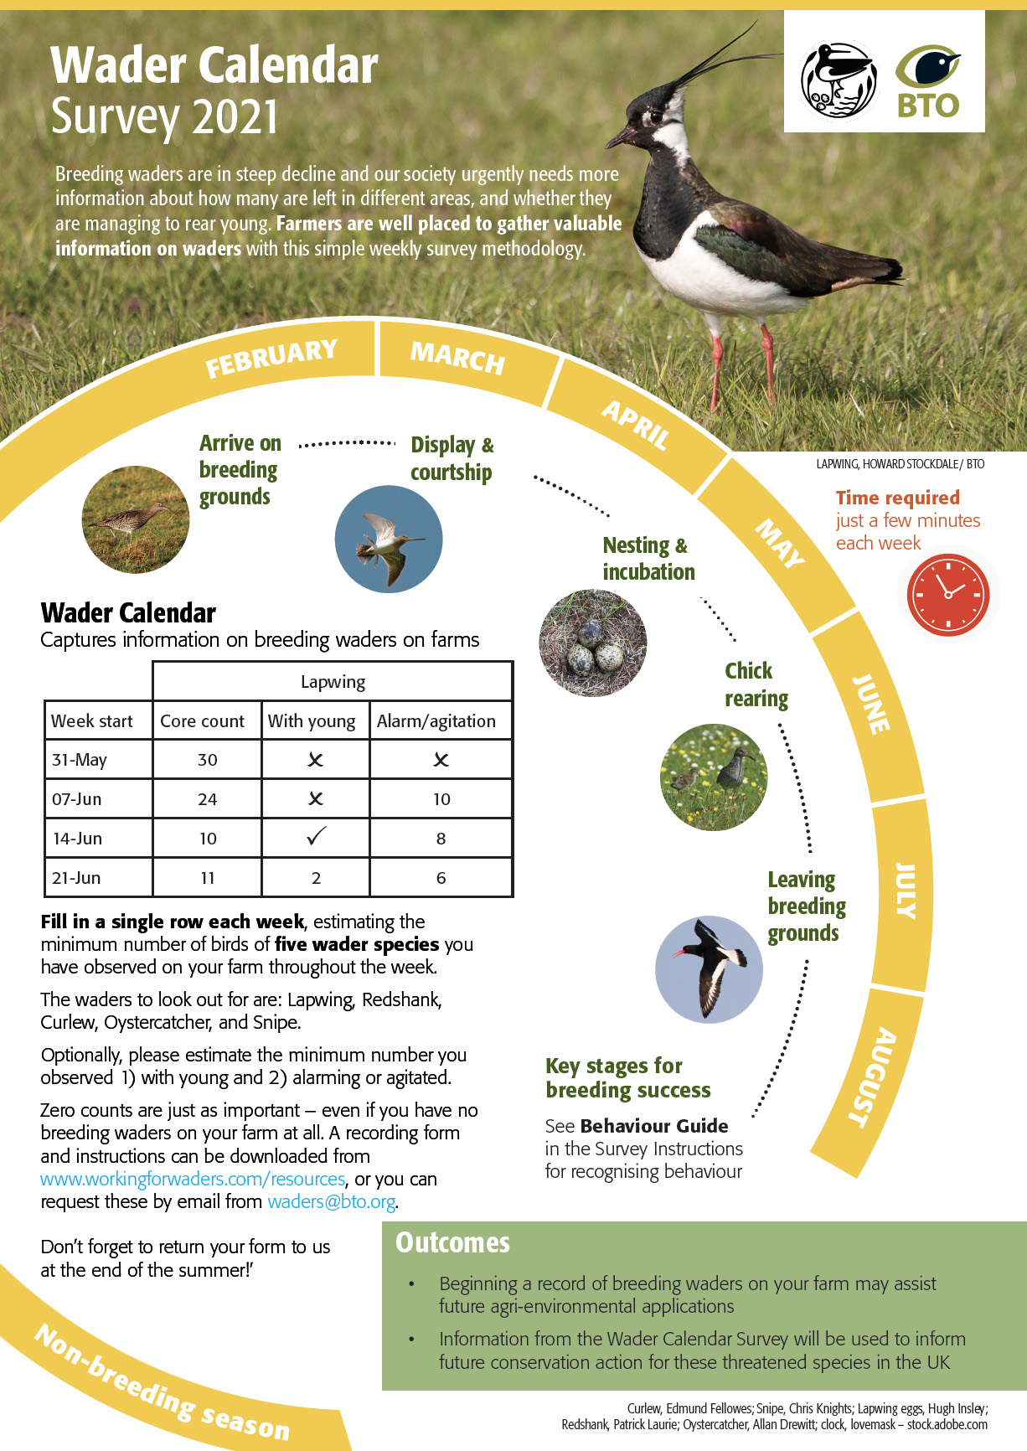
The Curlew Recovery Partnership: Resources
CRP Fieldworker Toolkit
BTO Wader Calendar

Slide 10
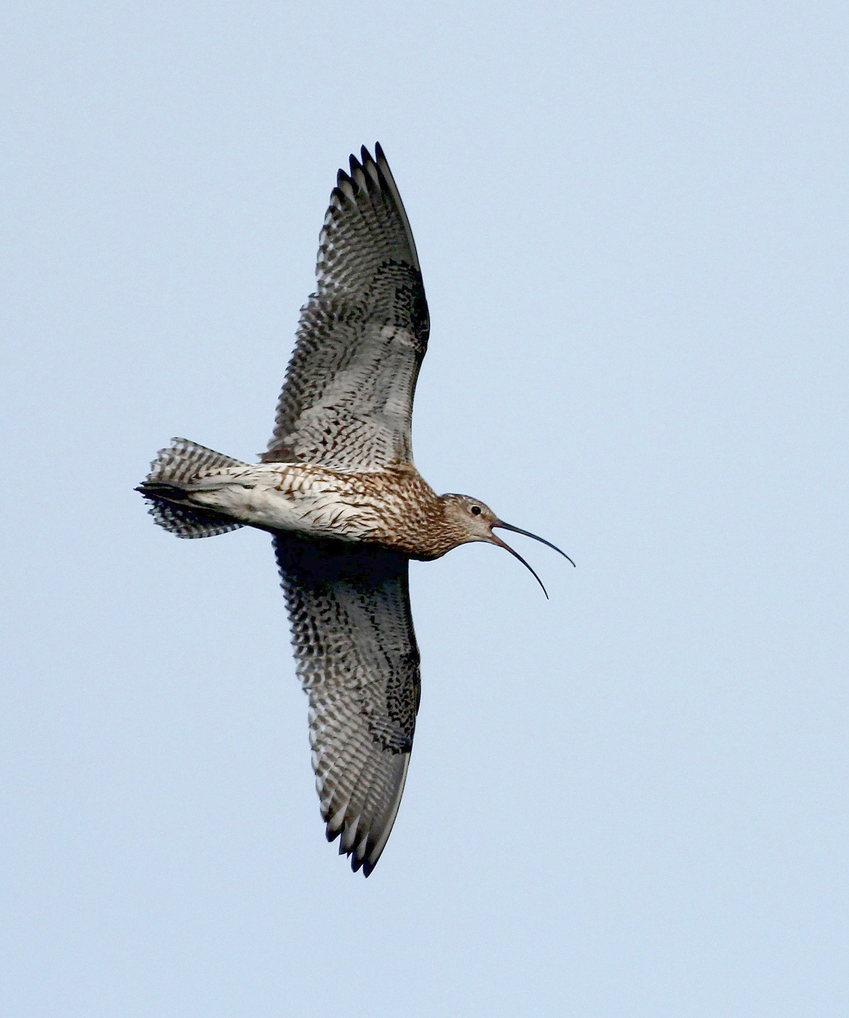
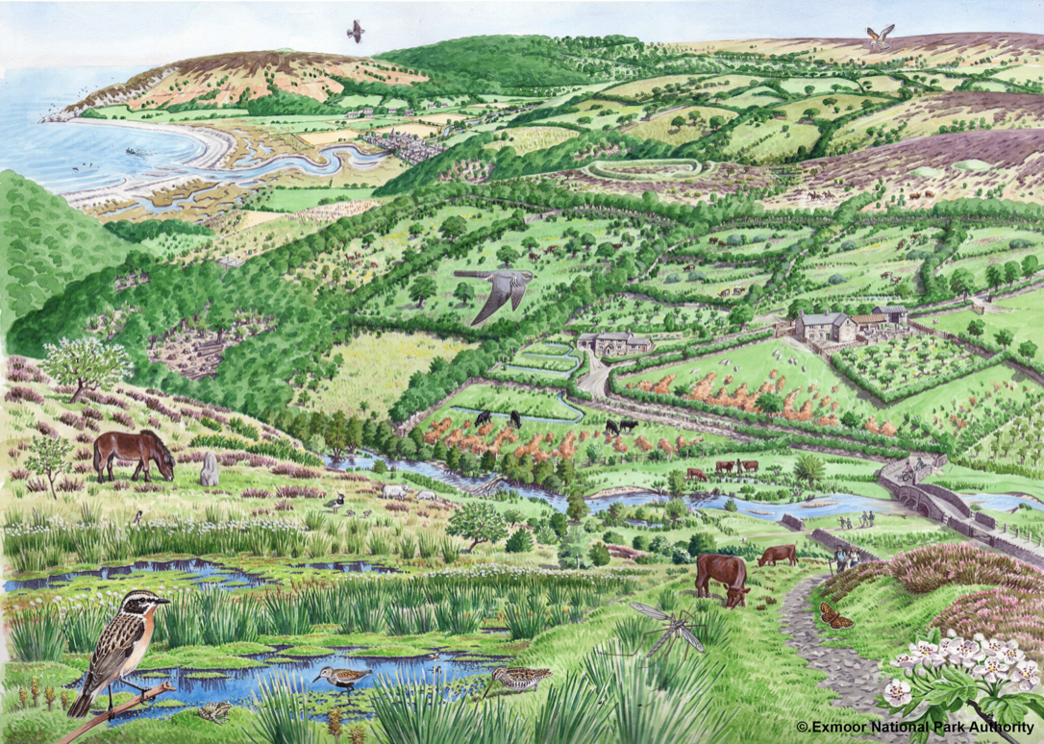
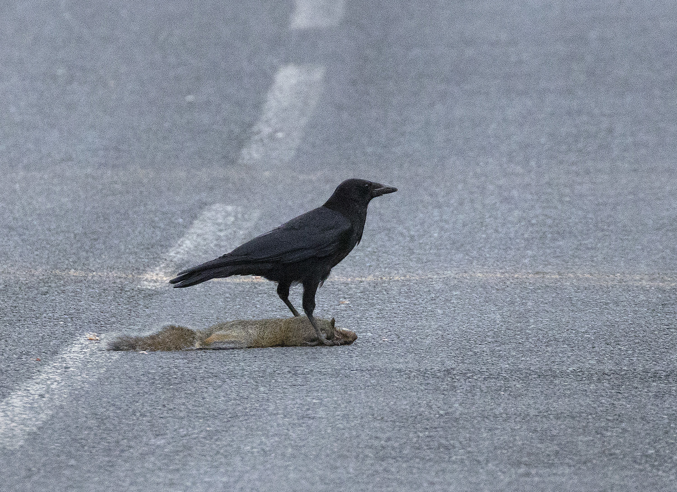
The Curlew Recovery Partnership: Future research

Slide 11
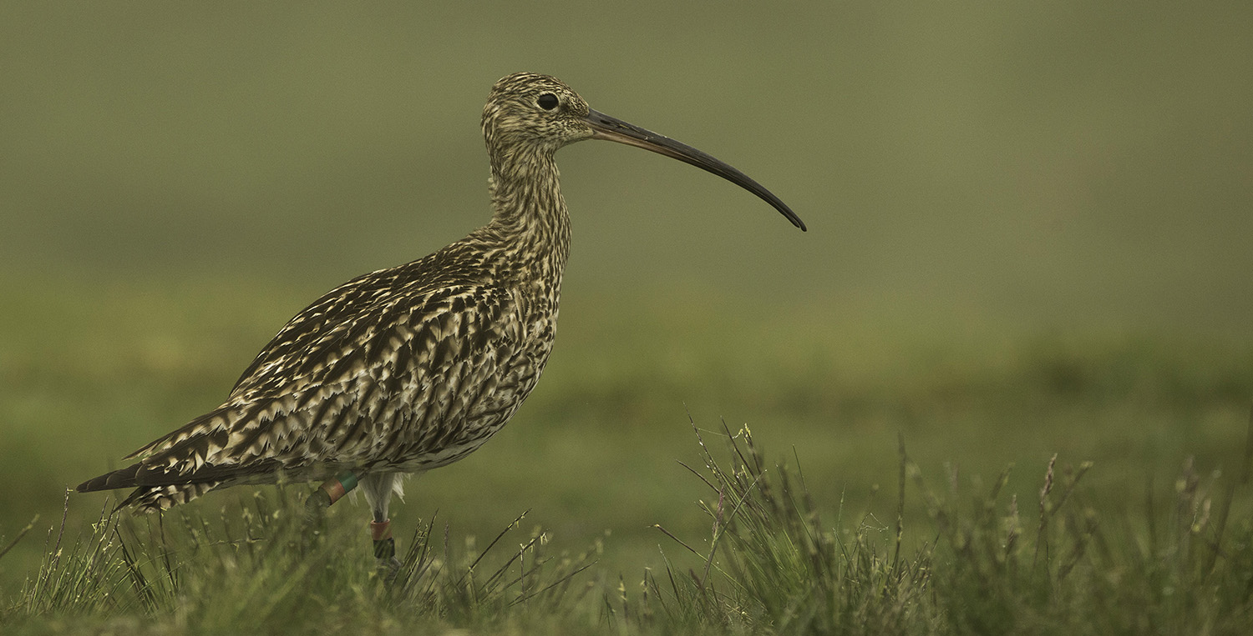
The Curlew Recovery Partnership: Join our network
Photo: Tom Streeter
Email: hello@curlewrecovery.org
Website: www.curlewrecovery.org

